Slide 1
Management & Governance
CW, CloudTrail, Organizations, Config, Trusted Advisor, CloudFormation, OpsWorks
AWS Certified Solutions Architect– Professional (SAP-C01)
Study notes - Sep’2019

Slide 2
CW

Slide 3
CW (1/3) - Overall
https://docs.aws.amazon.com/CW/index.html
Are we using CW agent? Which custom alarms are configured?
Which CW Events?
CW Monitoring
Use CW to monitor your AWS resources and your applications. The CW home page displays metrics about every AWS service you use. You can also create custom dashboards and create alarms which watch metrics and send notifications
1
CW Events
Use CW Events to send system events from AWS resources to AWS Lambda functions, Amazon SNS topics, streams in Amazon Kinesis, and other target types.
2
CW Logs
Use CW Logs to monitor, store, and access your log files from Amazon EC2 instances, AWS CloudTrail, or other sources.
3
Collecting Metrics and Logs from Amazon EC2 Instances and On-Premises Servers with the CW Agent
Collect more system-level metrics from Amazon EC2 instances across operating systems. The metrics can include in-guest metrics, in addition to the metrics for EC2 instances.
Collect system-level metrics from on-premises servers. These can include servers in a hybrid environment as well as servers not managed by AWS.
Retrieve custom metrics from your applications or services using the StatsD and collectd protocols. StatsD is supported on both Linux servers and servers running Windows Server. collectd is supported only on Linux servers.
Collect logs from Amazon EC2 instances and on-premises servers, running either Linux or Windows Server.
You can store and view the metrics that you collect with the CW agent in CW just as you can with any other CW metrics.
The logs collected by the unified CW agent are processed and stored in Amazon CW Logs, just like logs collected by the older CW Logs agent. Metrics collected by the CW agent are billed as custom metrics.

Slide 4
CW (2/3) - Logs
https://docs.aws.amazon.com/AmazonCW/latest/logs/WhatIsCWLogs.html
CW Logs enables you to centralize the logs from all of your systems, applications, and AWS services that you use, in a single, highly scalable service. You can then easily view them, search them for specific error codes or patterns, filter them based on specific fields, or archive them securely for future analysis. CW Logs enables you to create custom computations with a powerful query language, and visualize log data in dashboards.
Monitor Logs from Amazon EC2 Instances
Monitor AWS CloudTrail Logged Events
Log Retention
Archive Log Data
Log Route 53 DNS Queries
Analyzing Log Data with CW Logs Insights
CW Logs Insights enables you to interactively search and analyze your log data in Amazon CW Logs. You can perform queries to help you quickly and effectively respond to operational issues. If an issue occurs, you can use CW Logs Insights to identify potential causes and validate deployed fixes.
Sending Logs Directly to Amazon S3 - enabled for VPC Flow logs and AWS Global Accelerator flow logs
Some AWS services can publish logs directly to Amazon S3. This way, if your main requirement for logs is storage in Amazon S3, you can easily have the service producing the logs send them directly to Amazon S3 without setting up additional infrastructure.
Exporting Log Data to Amazon S3
You can export log data from your log groups to an Amazon S3 bucket and use this data in custom processing and analysis
Streaming CW Logs Data to Amazon Elasticsearch Service
You can configure a CW Logs log group to stream data to your ES cluster in near real-time through a CW Logs subscription.
Using CW Logs with Interface VPC Endpoints
Establish a private connection between your VPC and Cw Logs to send logs without sending them through the internet.

Slide 5
CW (3/3) - Events
https://docs.aws.amazon.com/AmazonCW/latest/events/WhatIsCWEvents.html
CW Events delivers a near real-time stream of system events that describe changes in resources. Using simple rule setup, you can match events and route them to one or more target functions or streams. CW Events becomes aware of operational changes as they occur. CW Events responds to these operational changes and takes corrective action as necessary, by sending messages to respond to the environment, activating functions, making changes, and capturing state information.
Use CW Events to schedule automated actions that self-trigger at certain times using cron or rate expressions.
Concepts
Events – Resources can generate events when their state changes. eg. EC2 -> pending to running. You can generate custom application-level events and publish them to CW Events. You can also set up scheduled events that are generated on a periodic basis.
Targets – A target processes events. Targets can include EC2 instances, Lambda functions, Kinesis streams, Amazon ECS tasks, Step Functions state machines, Amazon SNS topics, Amazon SQS queues, and built-in targets.
Rules – A rule matches incoming events and routes them to targets for processing.
Schedule Expressions for Rules
You can create rules that self-trigger on an automated schedule in CW Events using cron or rate expressions.
Rate expressions are simpler to define but don't offer the fine-grained schedule control that cron expressions support.
Tutorial: Use CW Events to Relay Events to AWS Systems Manager Run Command
Tutorial: Log the State of an Amazon EC2 Instance Using CW Events
Tutorial: Log Amazon S3 Object-Level Operations Using CW Events
Tutorial: Schedule AWS Lambda Functions Using CW Events
Tutorial: Set AWS Systems Manager Automation as a CW Events Target
Tutorial: Run an Amazon ECS Task When a File is Uploaded to an Amazon S3 Bucket

Slide 6
Real-time Processing of Log Data with Subscriptions
https://docs.aws.amazon.com/AmazonCW/latest/logs/Subscriptions.html
You can use subscriptions to get access to a real-time feed of log events from CW Logs and have it delivered to other services such as a
Amazon Kinesis stream,
Amazon Kinesis Data Firehose stream, or
AWS Lambda for custom processing, analysis, or loading to other systems.
To begin subscribing to log events, create the receiving source, such as a Kinesis stream, where the events will be delivered. A subscription filter defines the filter pattern to use for filtering which log events get delivered to your AWS resource, as well as information about where to send matching log events to.
CW Logs also produces CW metrics about the forwarding of log events to subscriptions.

Slide 7
Searching and Filtering Log Data
https://docs.aws.amazon.com/AmazonCW/latest/logs/MonitoringLogData.html
After the CW Logs agent begins publishing log data to CW, you can begin searching and filtering the log data by creating one or more metric filters. Metric filters define the terms and patterns to look for in log data as it is sent to CW Logs. CW Logs uses these metric filters to turn log data into numerical CW metrics that you can graph or set an alarm on. You can use any type of CW statistic, including percentile statistics, when viewing these metrics or setting alarms.
Example: Count Log Events
Example: Count Occurrences of a Term
Example: Count HTTP 404 Codes
Example: Count HTTP 4xx Codes
Example: Extract Fields from an Apache Log
https://console.aws.amazon.com/cloudwatch/ → Logs → Create Metric Filter → Define Logs Metric Filter → Filter Pattern [IP, UserInfo, User, Timestamp, RequestInfo, StatusCode=404, Bytes] → Select Log Data to Test → Test Pattern

Slide 8
AWS Organizations

Slide 9
AWS Organizations - Features
https://docs.aws.amazon.com/organizations/latest/userguide/orgs_getting-started_concepts.html
AWS Organizations is an account management service that enables you to consolidate multiple AWS accounts into an organization that you create and centrally manage.
Features:
Centralized management of all of your AWS accounts
Consolidated billing for all member accounts
Master account pays for all member accounts
Hierarchical grouping of your accounts to meet your budgetary, security, or compliance needs
Group into OUs
Attach policies to OUs that restrict access to services
You can nest OUs upto 5 levels
Control over the AWS services and API actions that each account can access
Use Service Control Policies (SCP) to set permissions
Possible to restrict which AWS services, resources, and individual API actions the users and roles in each member account can access.
These restrictions override the IAM policies set by administrators of the member accounts
Integration and support for AWS IAM
IAM provides granular control over users and roles in individual accounts.
AWS Organizations expands that control to the account level by giving you control over what users and roles in an account or a group of accounts can do.
Resulting permissions are a logical intersection of what is allowed by AWS Org. at the account level, and what permissions are explicitly granted by IAM at the user or role level within that account.
In other words, the user can access only what is allowed by both the AWS Organizations policies and IAM policies. If either blocks an operation, the user can't access that operation.
Integration with other AWS services
https://docs.aws.amazon.com/organizations/latest/userguide/orgs_integrated-services-list.html
Data replication that is eventually consistent

Slide 10
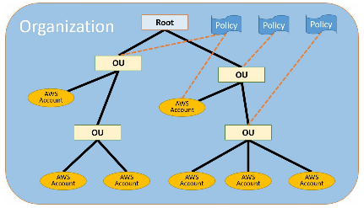
AWS Organizations - Concepts
https://docs.aws.amazon.com/organizations/latest/userguide/orgs_getting-started_concepts.html
Master account creates the org. The rest of the accounts that belong to an org. are called member accounts.
From the org.'s master account, you can create accounts in the org., invite other existing accounts to the org., remove accounts from the org., manage invitations, and apply policies to entities (roots, OUs, or accounts) within the org.
An account can be a member of only one org. at a time.
Service Control Policy (SCP)
A policy that specifies the services and actions that users and roles can use in the accounts that the SCP affects.
SCPs are similar to IAM permission policies except that they don't grant any permissions. Instead, SCPs specify the maximum permissions for an organization, OU or account.
You can attach an SCP to 1) A root, which affects all accounts in the org. 2) An OU, which affects all accounts in that OU and all accounts in any OUs in that OU subtree 3) An individual account
The master account is not affected by any SCPs that are attached either to it or to any root or OU the master account might be in.
AllowList / whitelist (default-FullAWSAccess-replace)
DenyList / blacklist (default-FullAWSAccess-Add denylist)
Invitation:
Process of asking another account to join your org.
Invitations can also be sent to all current member accounts when the org. needs all members to approve the change from supporting only consolidated billing features to supporting all features in the org.
Handshake:
One of its primary uses in AWS Org. is to serve as the underlying implementation for invitations.
Available feature sets
All features OR
Consolidated Billing

Slide 11
AWS Organizations - Moving from “Consolidated billing” to “All features”
Before changing from an organization that supports only consolidated billing features to an organization supporting “All features”, note the following:
AWS Org. sends a request to every member account that you invited to join your org. Every invited account must approve enabling all features by accepting the request.
Org. verifies that every account has a service-linked role named AWSServiceRoleForOrganizations. This role is mandatory in all accounts to enable all features.
While enabling all features is in progress, you can continue to create accounts within the org. but you can't invite existing accounts to join the org.
Because enabling all features makes it possible to use SCPs, be sure that your account administrators understand the effects of attaching SCPs to the org., OUs or accounts.
The master account isn't affected by any SCP. You can't limit what users and roles in the master account can do by applying SCPs. SCPs affect only member accounts.
The migration from consolidated billing features to all features is one-way.
If your organization has only consolidated billing features enabled, member account administrators can choose to delete the service-linked role named AWSServiceRoleForOrganizations. However, when you enable all features in an organization, this role is required and is recreated in all accounts as part of accepting the invitation to enable all features.

Slide 12
AWS Organizations - Impact on member accounts
https://docs.aws.amazon.com/organizations/latest/userguide/orgs_getting-started_concepts.html
Impact on an AWS Account That You Invite to Join an Organization:
When an invited account joins your organization, you do not automatically have full administrator control over the account, unlike created accounts. If you want the master account to have full administrative control over an invited member account, you must create the OrganizationAccountAccessRole IAM role in the member account and grant permission to the master account to assume the role.
AWS Organizations does automatically create a service-linked role called AWSServiceRoleForOrganizations in invited member accounts to support integration between AWS Organizations and other AWS services.
If you have any service control policies (SCPs) attached to the root of the OU tree, those SCPs immediately apply to all users and roles in the invited account.
If you have enabled service trust for another AWS service for your organization, that trusted service can create service-linked roles or perform actions in any member account in the organization, including an invited account.
Impact on an AWS Account That You Create in an Organization
AWS Organizations creates the IAM role OrganizationAccountAccessRole.
AWS Organizations creates a service-linked role called AWSServiceRoleForOrganizations. The account must have this role if your organization supports all features.
If you have any SCPs attached to the root of the OU tree, those SCPs immediately apply to all users and roles in the created account. New accounts are added to the root OU by default.
If you have enabled service trust for another AWS service for your organization, that trusted service can create service-linked roles or perform actions in any member account in the organization, including an invited account.

Slide 13
AWS Organizations - Service Control Policy (SCP)
SCPs offer central control over the maximum available permissions for all accounts in your organization, allowing you to ensure your accounts stay within your organization’s access control guidelines.
SCPs are available only in an organization that has all features enabled (not just consolidated billing).
SCPs are necessary but not sufficient for granting access in the accounts in your org. You still need to attach IAM policies to users and roles in your org's accounts to actually grant permissions to them.
Any account has only those permissions permitted by every parent above it. If a permission is blocked at any level above the account, either implicitly (by not being included in an Allow policy statement) or explicitly (by being included in a Deny policy statement), a user or role in the affected account can't use that permission, even if the account administrator attaches the AdministratorAccess IAM policy with */* permissions to the user.
An SCP never grants permissions. Instead, SCPs are JSON policies that specify the maximum permissions for an organization or OU.
A user without any IAM permission policies has no access at all, even if the applicable SCPs allow all services and all actions.
If a user or role has an IAM permission policy that grants access to an action that is also allowed by the applicable SCPs, the user or role can perform that action.
If a user or role has an IAM permission policy that grants access to an action that is either not allowed or explicitly denied by the applicable SCPs, the user or role can't perform that action.
SCPs affect all users and roles in attached accounts, including the root user.
SCPs do not affect any service-linked role.
SCPs affect only principals that are managed by accounts that are part of the organization. They don't affect users or roles from accounts outside the organization.
When you disable the SCP policy type in a root, all SCPs are automatically detached from all entities in that root.

Slide 14
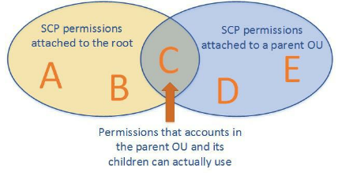
AWS Organizations - How SCPs work
Because the root's OU doesn't allow D or E, nothing in the root or any of its children can use them, including the parent OU.
Also, because the OU's SCP doesn't allow A or B, those permissions are blocked for the parent OU and any of its children. However, other OUs under the root that are peers to the parent OU could allow A and B.
When you attach SCPs to the root, OUs, or directly to accounts, all policies that affect a given account are evaluated together using the same rules that govern IAM permission policies
Any action that has an explicit Deny in an SCP can't be delegated to users or roles in the affected accounts.
An explicit Deny statement overrides any Allow that other SCPs might grant.
Any action that has an explicit Allow in an SCP (such as the default "*" SCP or by any other SCP that calls out a specific service or action) can be delegated to users and roles in the affected accounts.
Any action that isn't explicitly allowed by an SCP is implicitly denied and can't be delegated to users or roles in the affected accounts.
By default, an SCP named FullAWSAccess is attached to every root, OU, and account. This default SCP allows all actions and all services. So in a new organization, until you start creating or manipulating the SCPs, all of your existing IAM permissions continue to operate as they did.
As soon as you apply a new or modified SCP to a root or OU that contains an account, the permissions that your users have in that account become filtered by the SCP. Permissions that used to work might now be denied if they're not allowed by the SCP at every level of the hierarchy down to the specified account.

Slide 15
AWS Organizations - Allow vs Denylist
{
"Version": "2012-10-17",
"Statement": [
{
"Sid": "AllowsAllActions",
"Effect": "Allow",
"Action": "*",
"Resource": "*"
},
{
"Sid": "DenyDynamoDB",
"Effect": "Deny",
"Action": "dynamodb:*",
"Resource": "*"
}
]
}
The organization administrator can detach the FullAWSAccess policy and attach this one instead. This SCP still allows all other services and their actions.
A deny list (default) – actions are allowed by default, and you specify what services and actions are prohibited
An allow list – actions are prohibited by default, and you specify what services and actions are allowed
AWS Organizations attaches an AWS managed SCP named FullAWSAccess to every root and OU when it's created. This policy allows all services and actions.
This policy enables account administrators to delegate permissions for any service or action until you create and attach an SCP that denies some access.
An explicit Deny overrides an explicit Allow, which overrides the default implicit Deny
You could also configure this by leaving the FullAWSAccess policy in place and then attaching a second policy that has only the Deny statement in it, as shown here. {
"Version": "2012-10-17",
"Statement": [
{
"Effect": "Deny",
"Action": "dynamodb:*",
"Resource": "*"
}
]
}
Using SCPs as an Allow List:
To use SCPs as an allow list, you must replace the AWS managed FullAWSAccess SCP with an SCP that explicitly permits only those services and actions that you want to allow.

Slide 16
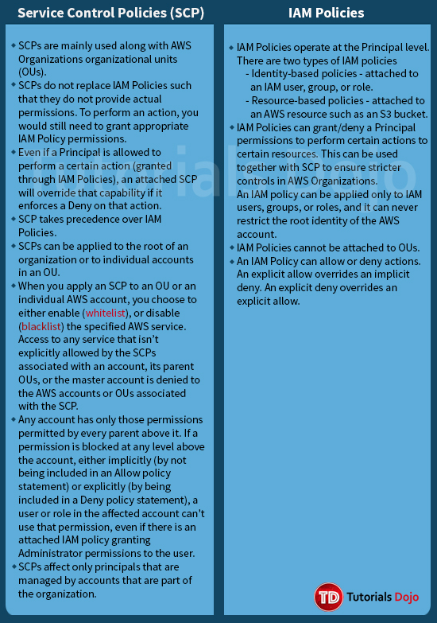

Slide 17
CloudFormation

Slide 18
AWS CloudFormation Best practices
https://docs.aws.amazon.com/AWSCloudFormation/latest/UserGuide/best-practices.html
Planning and organizing
Organize Your Stacks By Lifecycle and Ownership
Use Cross-Stack References to Export Shared Resources
Use IAM to Control Access
Reuse Templates to Replicate Stacks in Multiple Environments
Verify Quotas for All Resource Types
Use Nested Stacks to Reuse Common Template Patterns
Creating templates
Do Not Embed Credentials in Your Templates
Use AWS-Specific Parameter Types
Use Parameter Constraints
Use AWS::CloudFormation::Init to Deploy Software Applications on Amazon EC2 Instances
Use the Latest Helper Scripts
Validate Templates Before Using Them
Managing stacks
Manage All Stack Resources Through AWS CloudFormation
Create Change Sets Before Updating Your Stacks
Use Stack Policies
Use AWS CloudTrail to Log AWS CloudFormation Calls
Use Code Reviews and Revision Controls to Manage Your Templates
Update Your Amazon EC2 Linux Instances Regularly

Slide 19
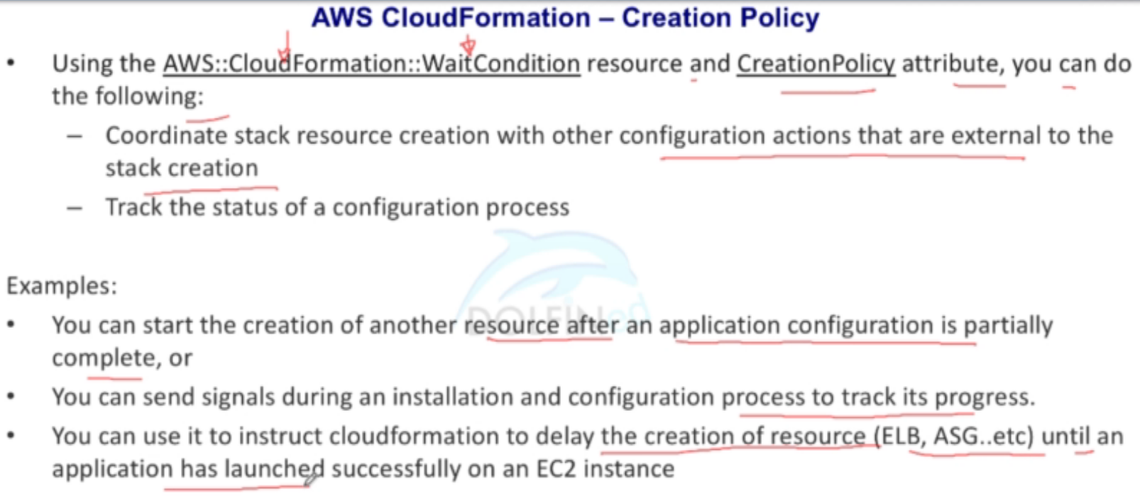
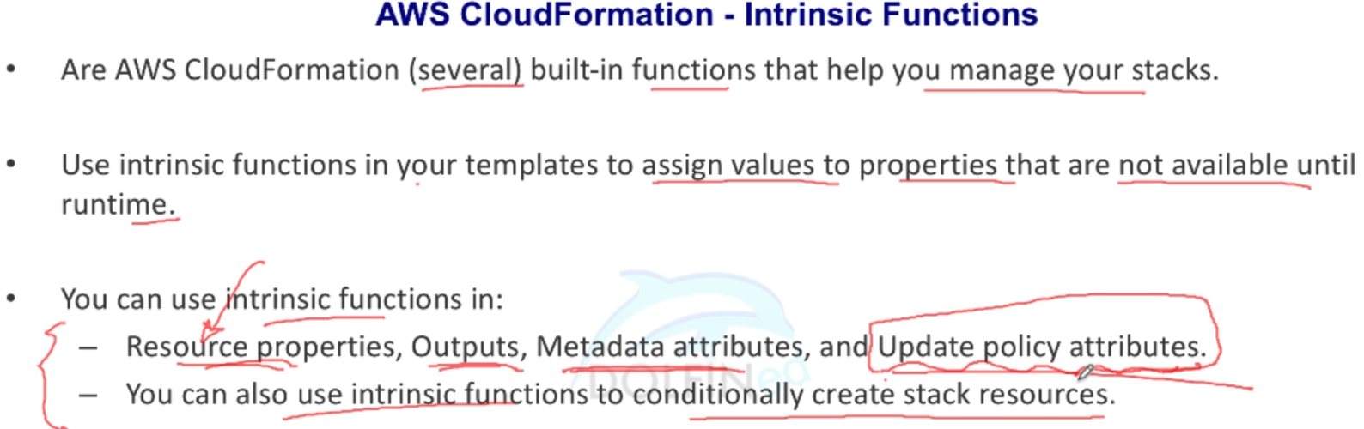
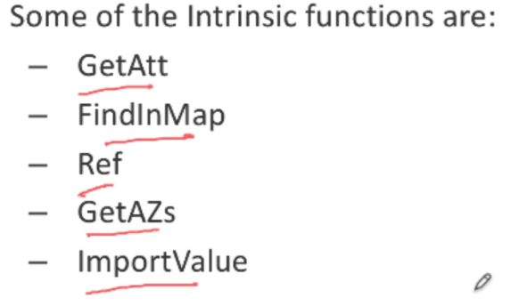
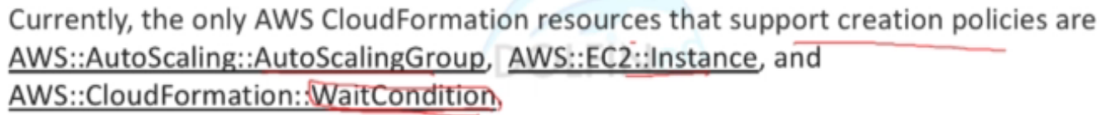
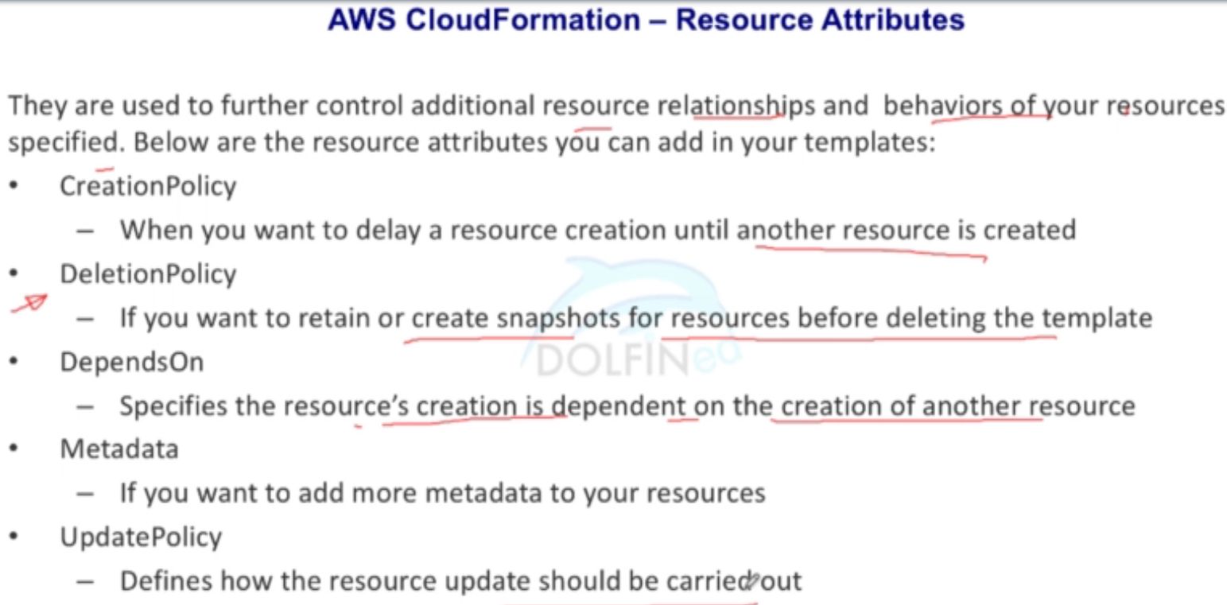
AWS CloudFormation
https://docs.aws.amazon.com/AWSCloudFormation/latest/UserGuide/intrinsic-function-reference.html

Slide 20
Refer to Resource Outputs in Another AWS CloudFormation Stack
https://docs.aws.amazon.com/AWSCloudFormation/latest/UserGuide/walkthrough-crossstackref.html
To export resources from one AWS CloudFormation stack to another, create a cross-stack reference. Cross-stack references let you use a layered or service-oriented architecture. Instead of including all resources in a single stack, you create related AWS resources in separate stacks; then you can refer to required resource outputs from other stacks. By restricting cross-stack references to outputs, you control the parts of a stack that are referenced by other stacks.
For example, you might have a network stack with a VPC, a security group, and a subnet for public web applications, and a separate public web application stack. To ensure that the web applications use the security group and subnet from the network stack, you create a cross-stack reference that allows the web application stack to reference resource outputs from the network stack. With a cross-stack reference, owners of the web application stacks don't need to create or maintain networking rules or assets.
To create a cross-stack reference, use the Export output field to flag the value of a resource output for export. Then, use the Fn::ImportValue intrinsic function to import the value.

Slide 21
DeletionPolicy Attribute
https://docs.aws.amazon.com/AWSCloudFormation/latest/UserGuide/aws-attribute-deletionpolicy.html
With the DeletionPolicy attribute you can preserve or (in some cases) backup a resource when its stack is deleted. You specify a DeletionPolicy attribute for each resource that you want to control. If a resource has no DeletionPolicy attribute, AWS CloudFormation deletes the resource by default.
DeletionPolicy Options
Delete
AWS CloudFormation deletes the resource and all its content if applicable during stack deletion. You can add this deletion policy to any resource type. By default, if you don't specify a DeletionPolicy, AWS CloudFormation deletes your resources. However, be aware of the following considerations:
For AWS::RDS::DBCluster resources, the default policy is Snapshot.
For AWS::RDS::DBInstance resources that don't specify the DBClusterIdentifier property, the default policy is Snapshot.
For Amazon S3 buckets, you must delete all objects in the bucket for deletion to succeed.
Retain
Keeps the resource without deleting the resource or its contents when its stack is deleted. When AWS CloudFormation completes the stack deletion, the stack will be in Delete_Complete state; however, resources that are retained continue to exist and continue to incur applicable charges until you delete those resources.
If a resource is deleted, the DeletionPolicy retains the physical resource but ensures that it's deleted from CF scope.
If a resource is updated such that a new physical resource is created to replace the old resource, then the old resource is completely deleted, including from AWS CloudFormation's scope.
Snapshot
For resources that support snapshots, AWS CloudFormation creates a snapshot for the resource before deleting it. Note that when AWS CloudFormation completes the stack deletion, the stack will be in the Delete_Complete state; however, the snapshots that are created with this policy continue to exist and continue to incur applicable charges until you delete those snapshots. Resources that support snapshots include:
AWS::EC2::Volume, AWS::ElastiCache::CacheCluster, AWS::ElastiCache::ReplicationGroup, AWS::Neptune::DBCluster
AWS::RDS::DBCluster, AWS::RDS::DBInstance, AWS::Redshift::Cluster

Slide 22
Elastic BeanStalk

Slide 23
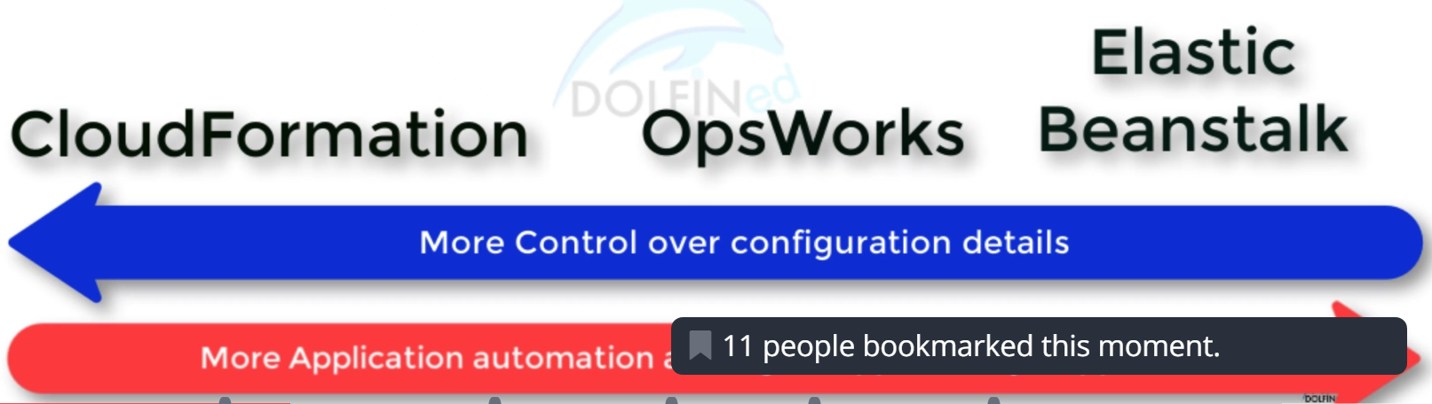
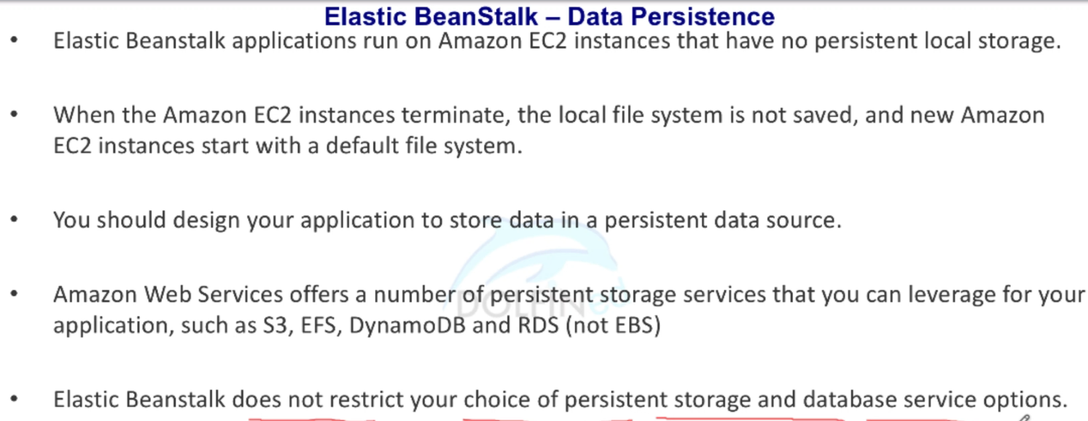
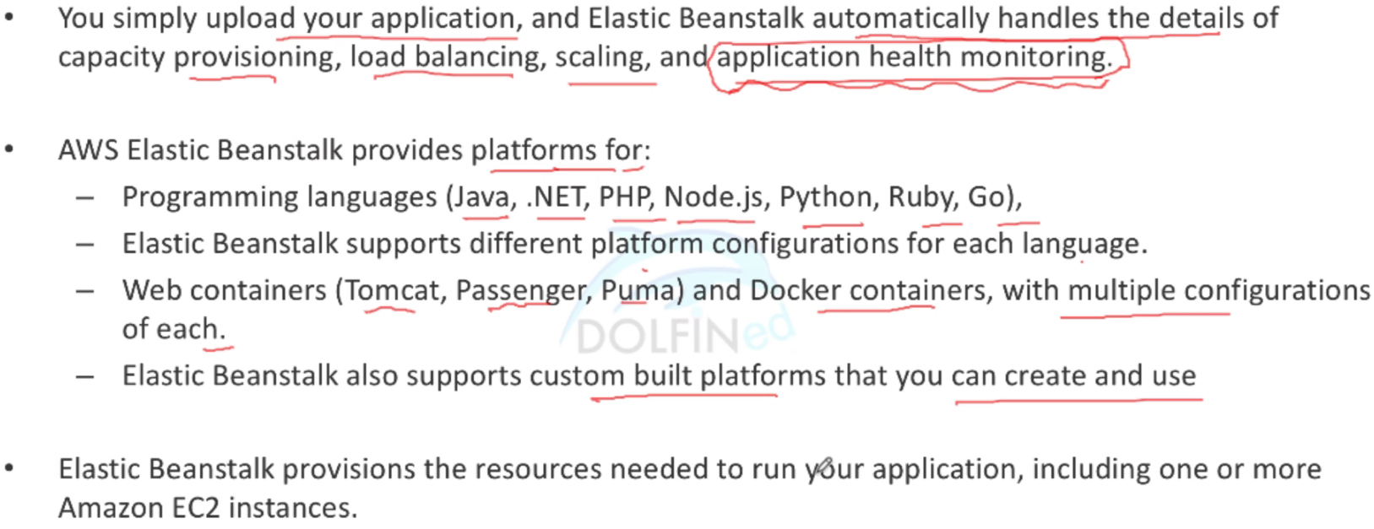
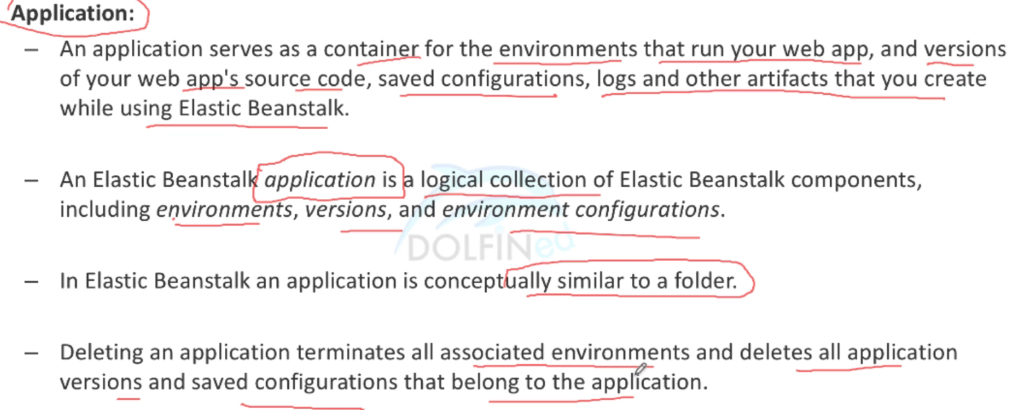
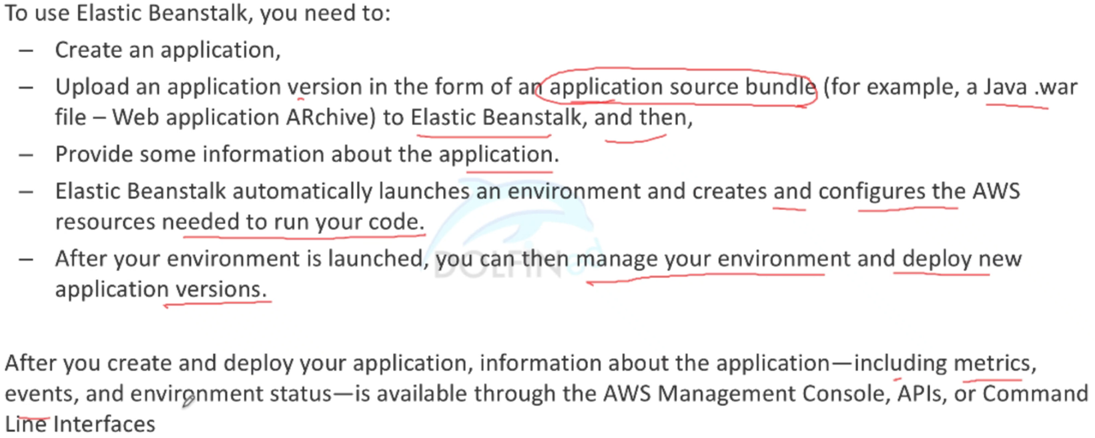
AWS Elastic Beanstalk

Slide 24
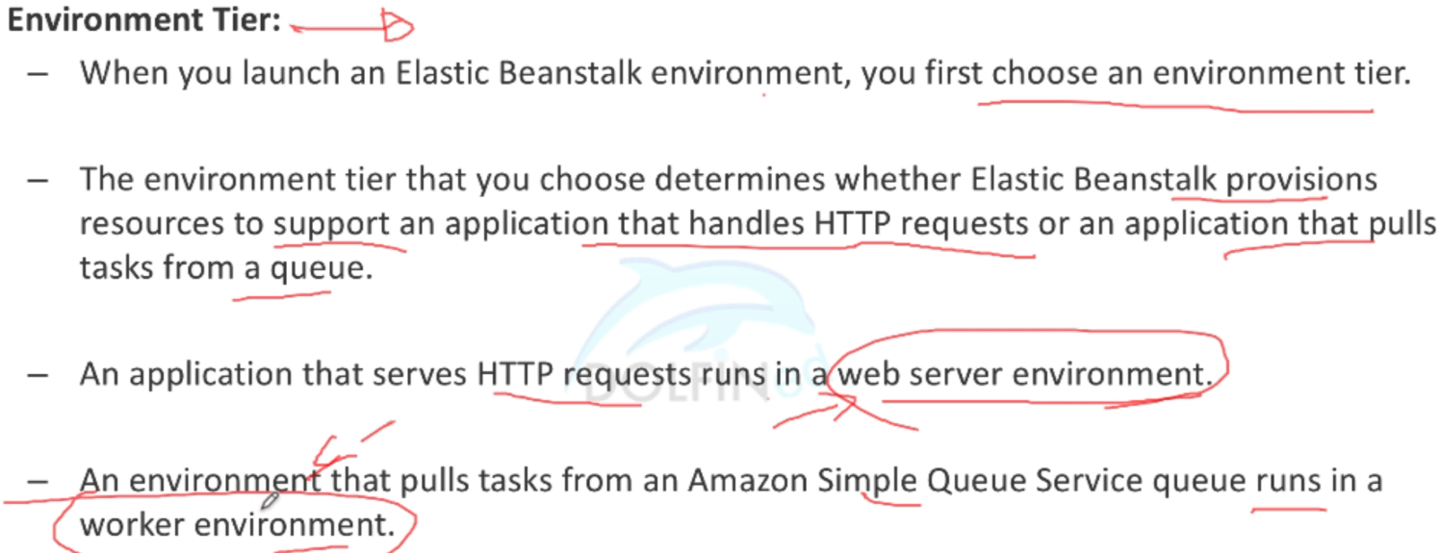
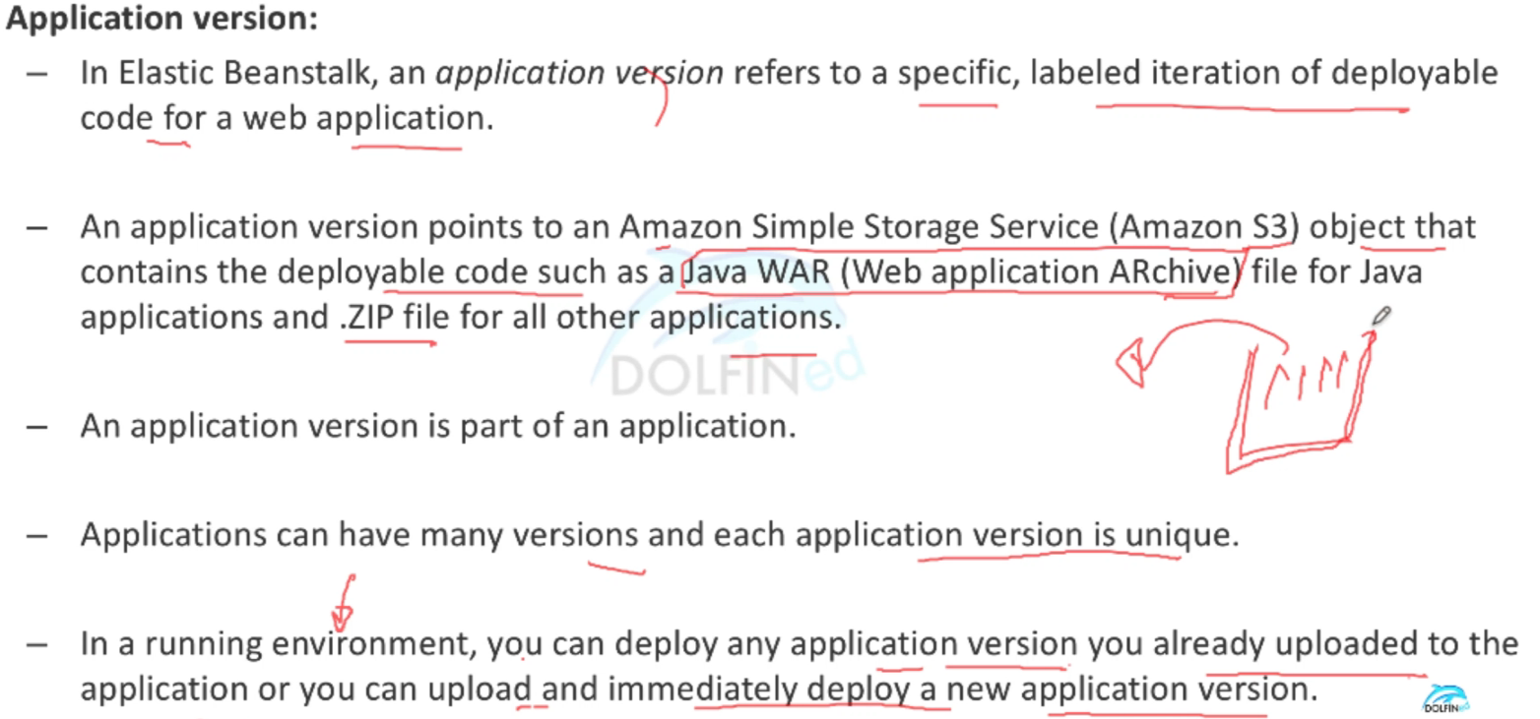
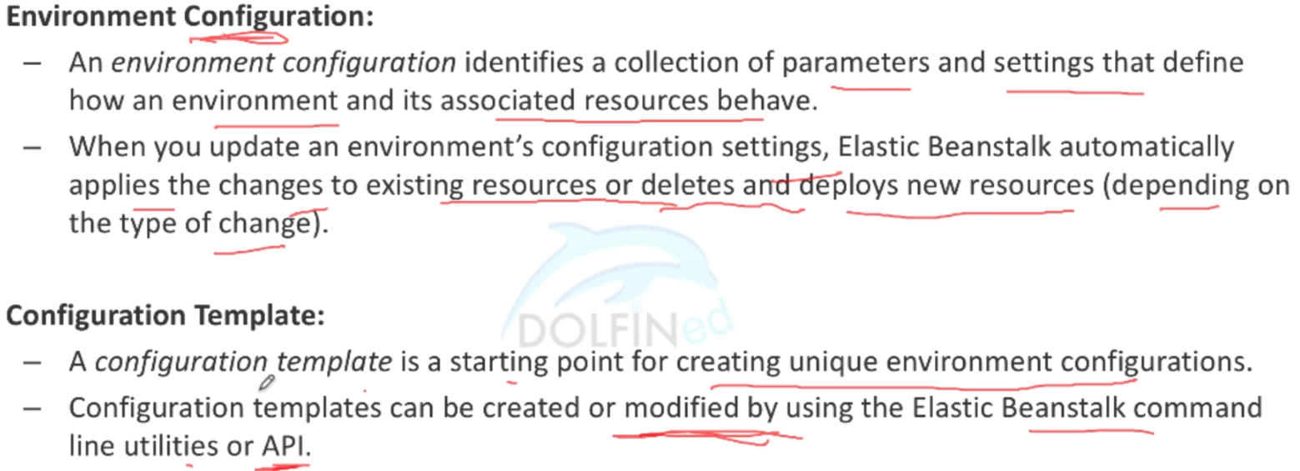
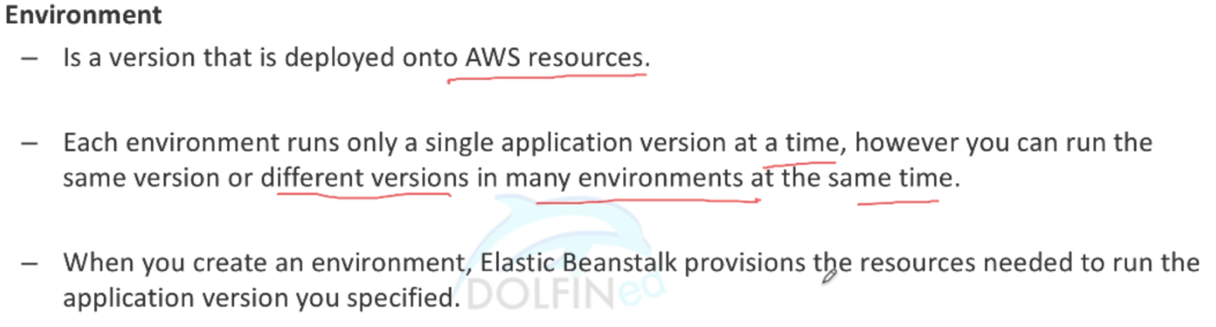
AWS Elastic Beanstalk

Slide 25
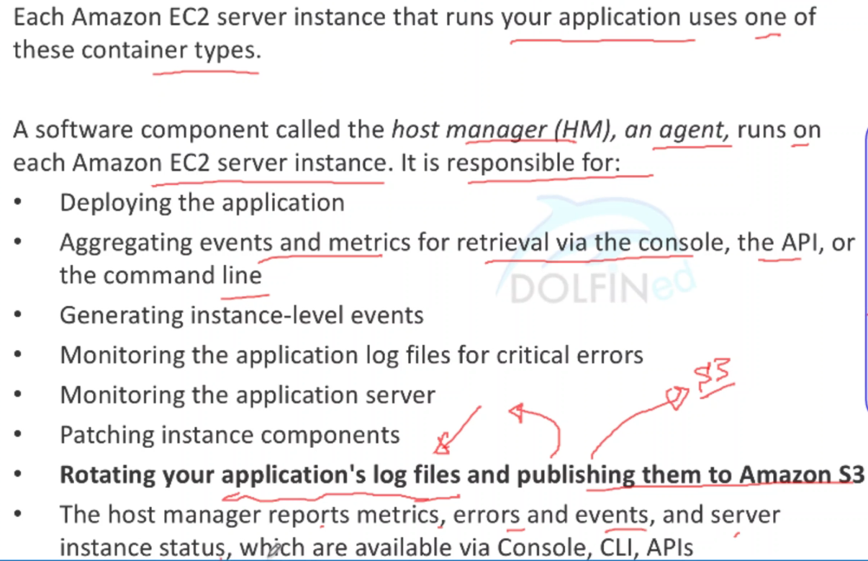
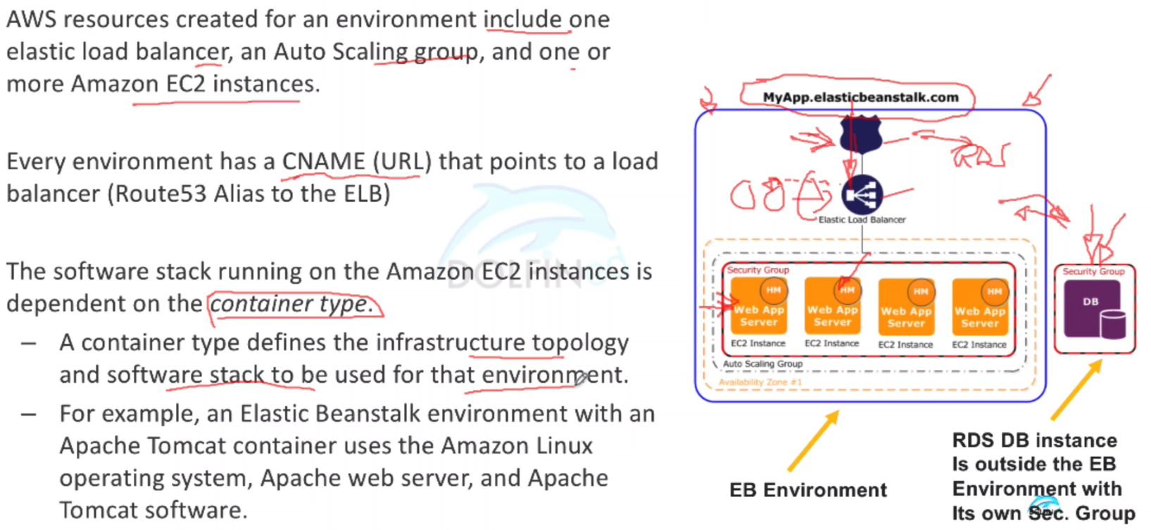
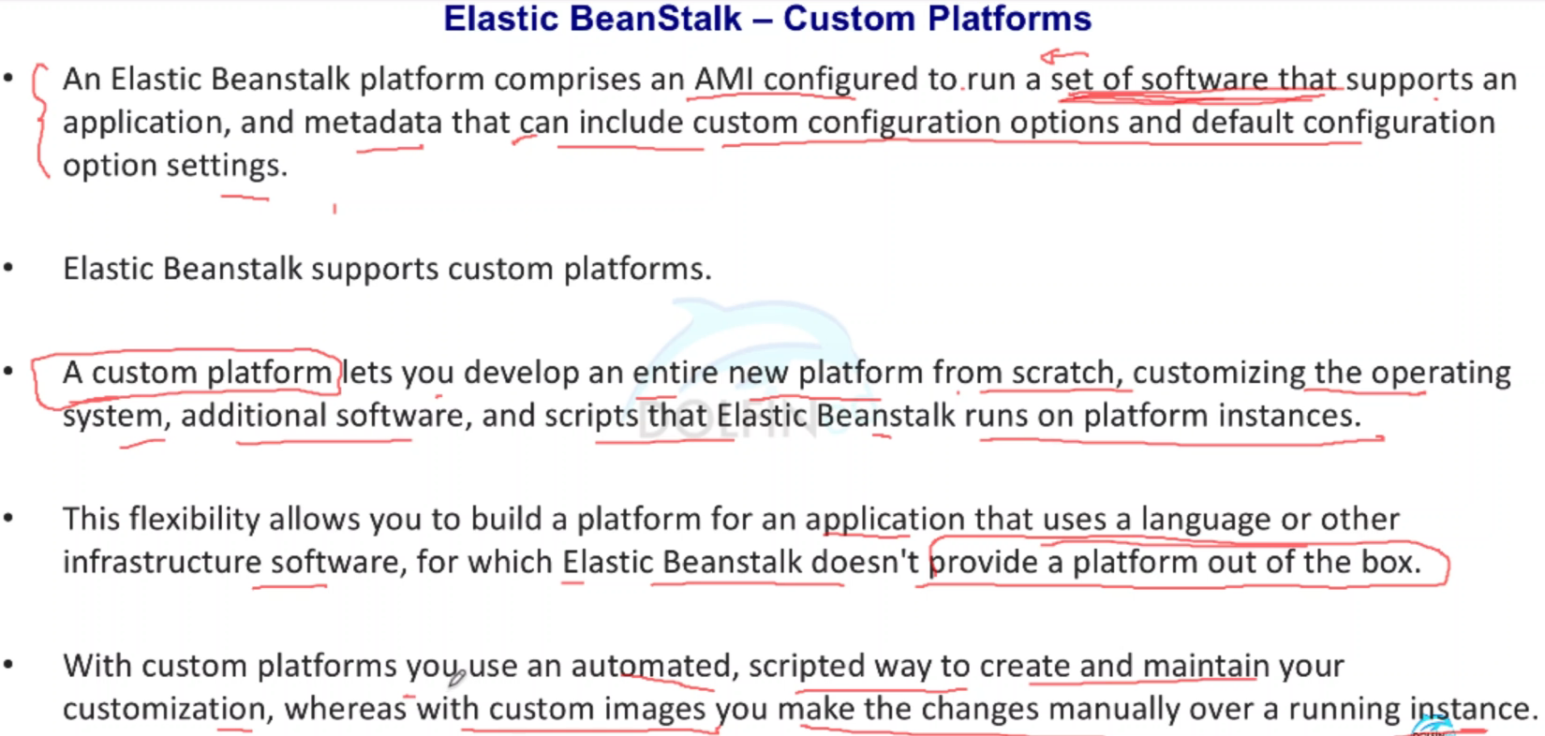
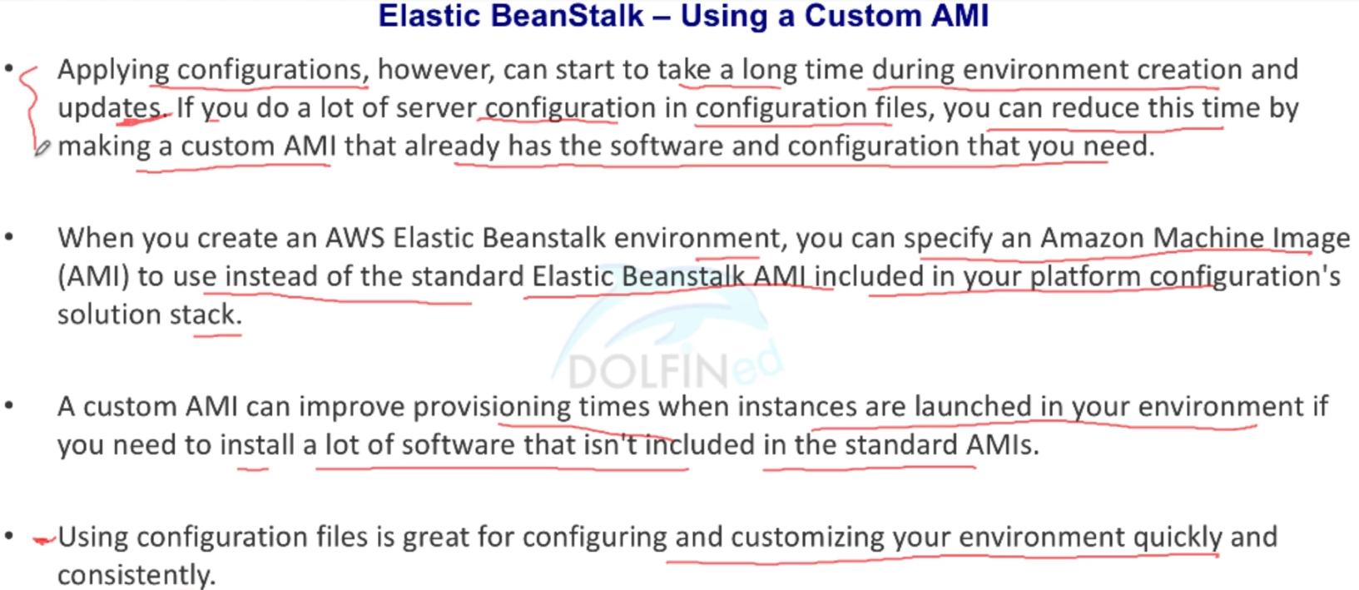
AWS Elastic Beanstalk
Key difference from OpsWorks

Slide 26
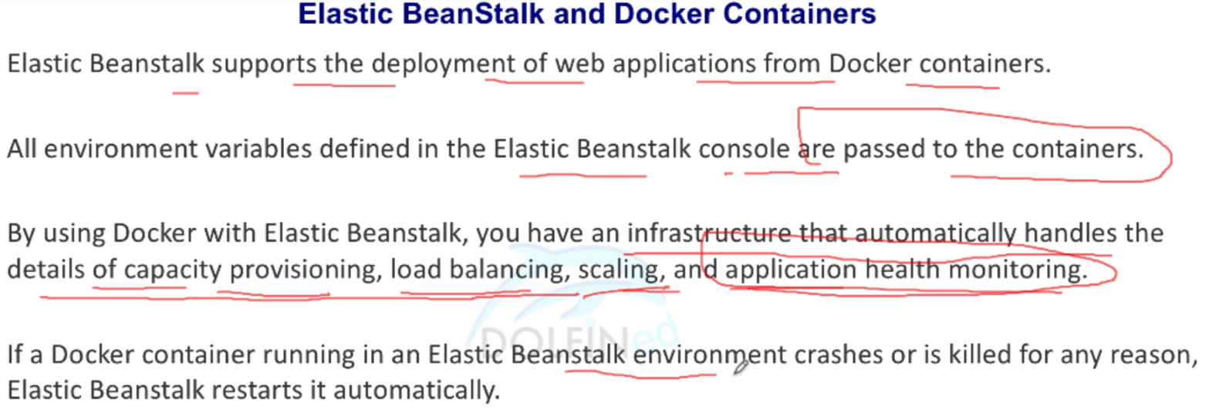
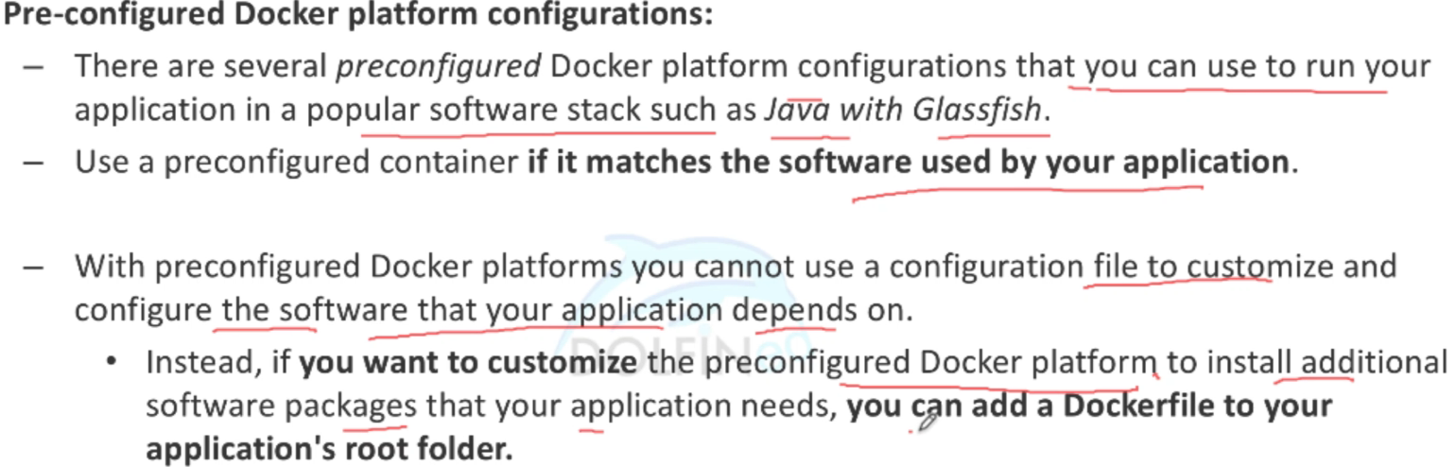
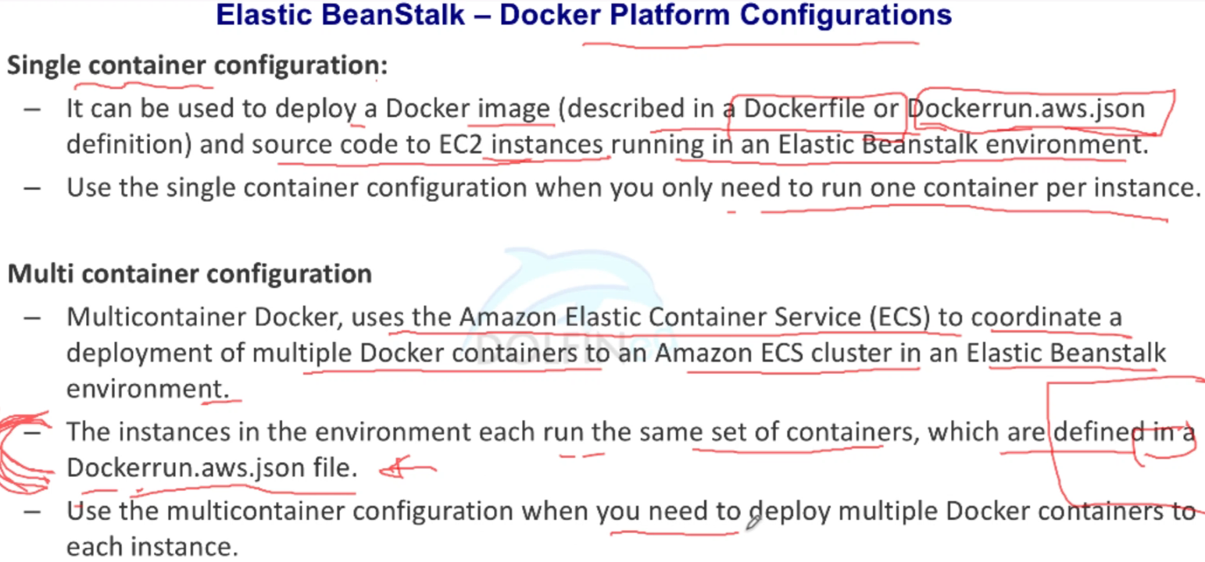
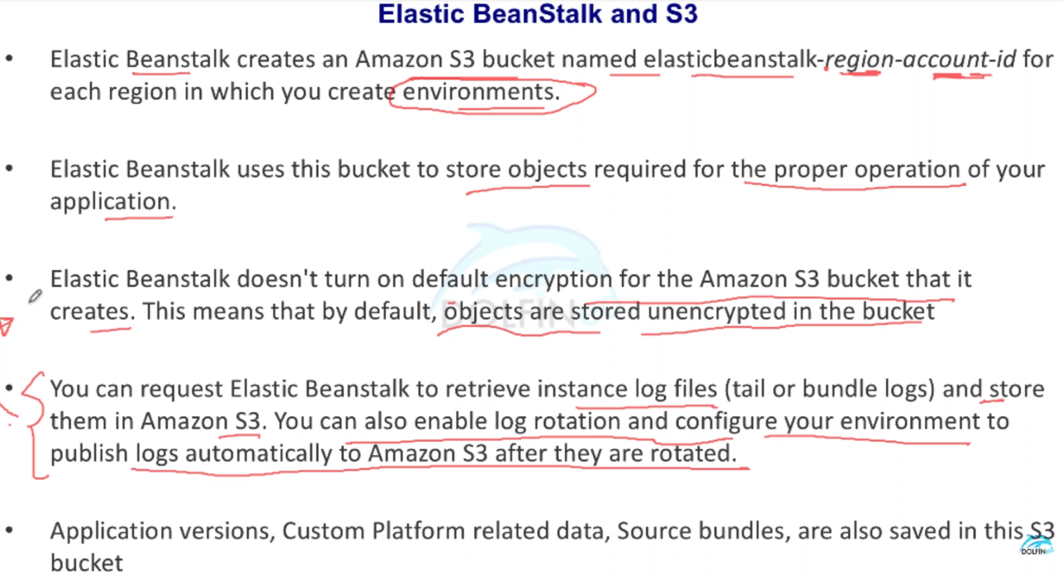
AWS Elastic Beanstalk
Migrating custom apps from on-prem to AWS, a possible option is to use custom built containers or use pre-configured docker platforms if it matches your tech stack

Slide 27
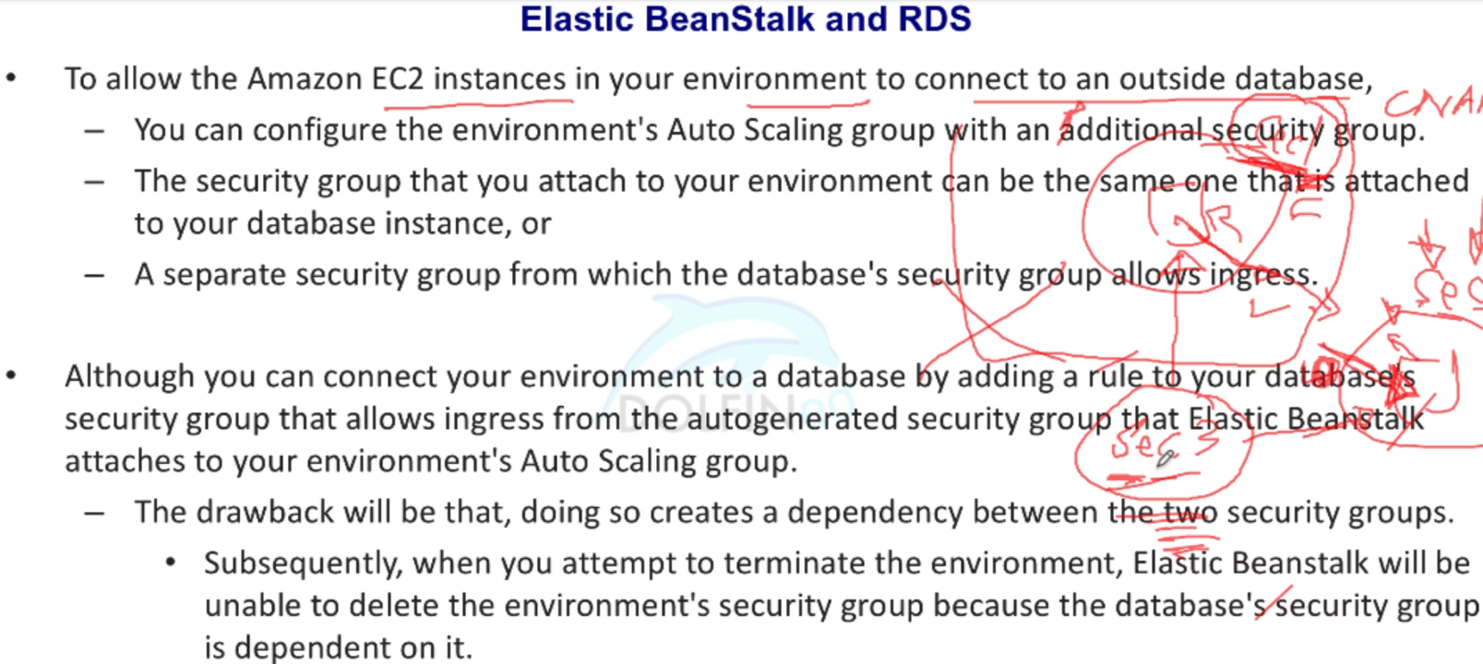
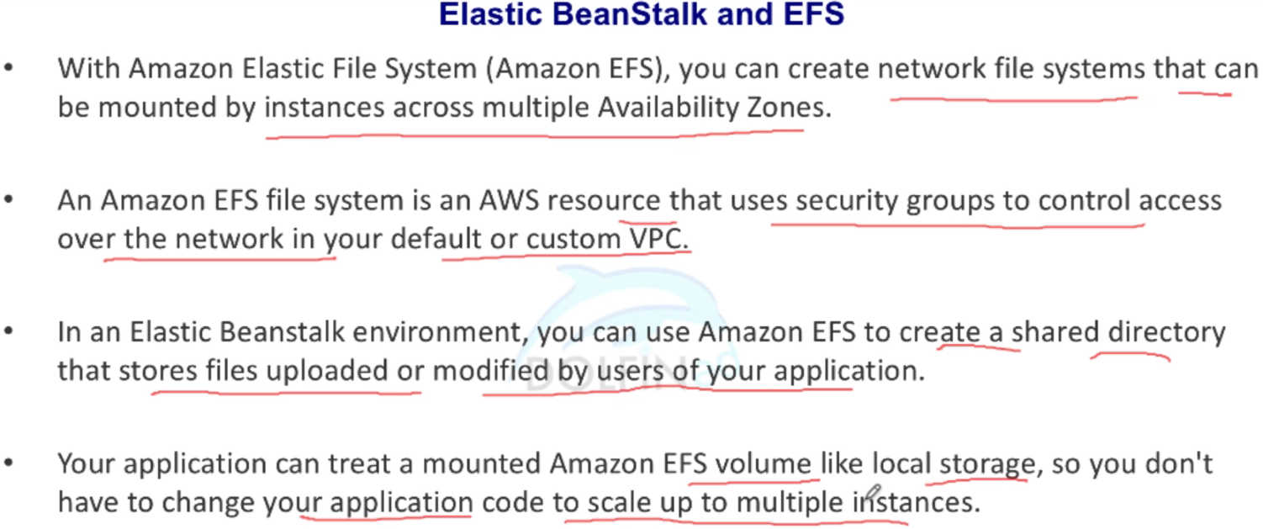
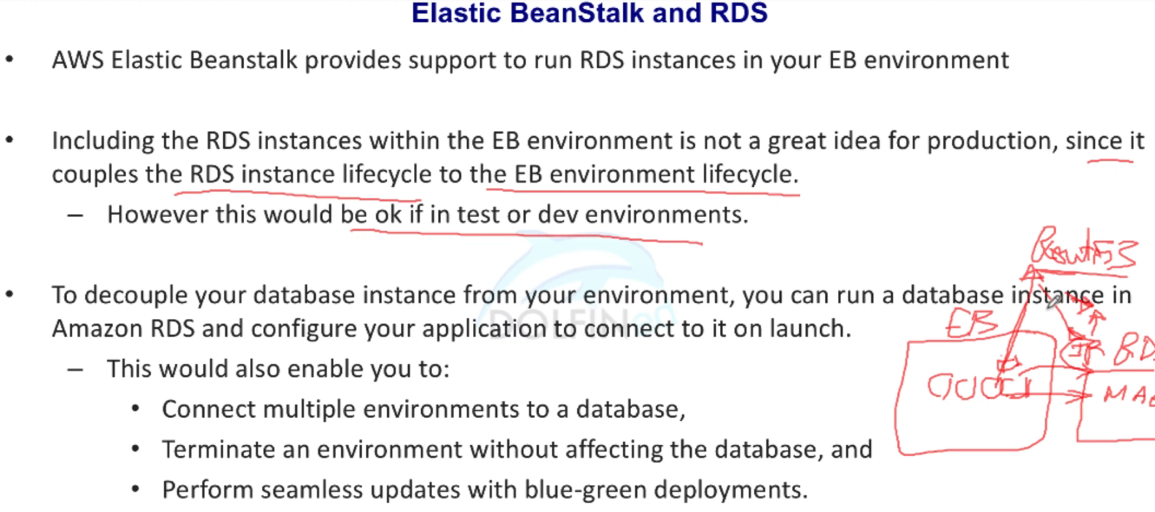
AWS Elastic Beanstalk

Slide 28
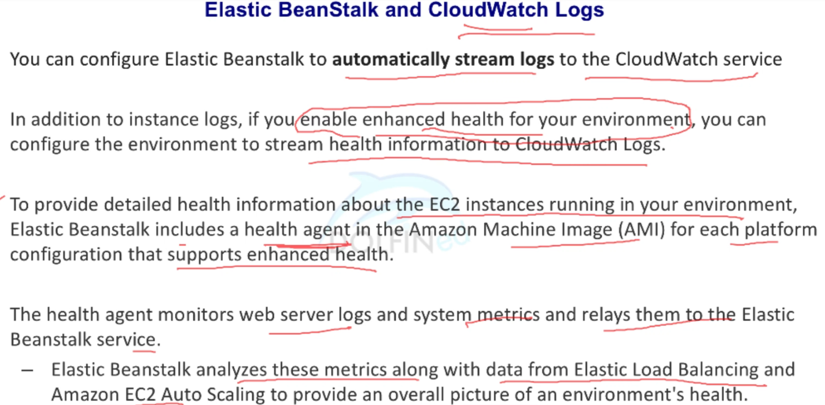
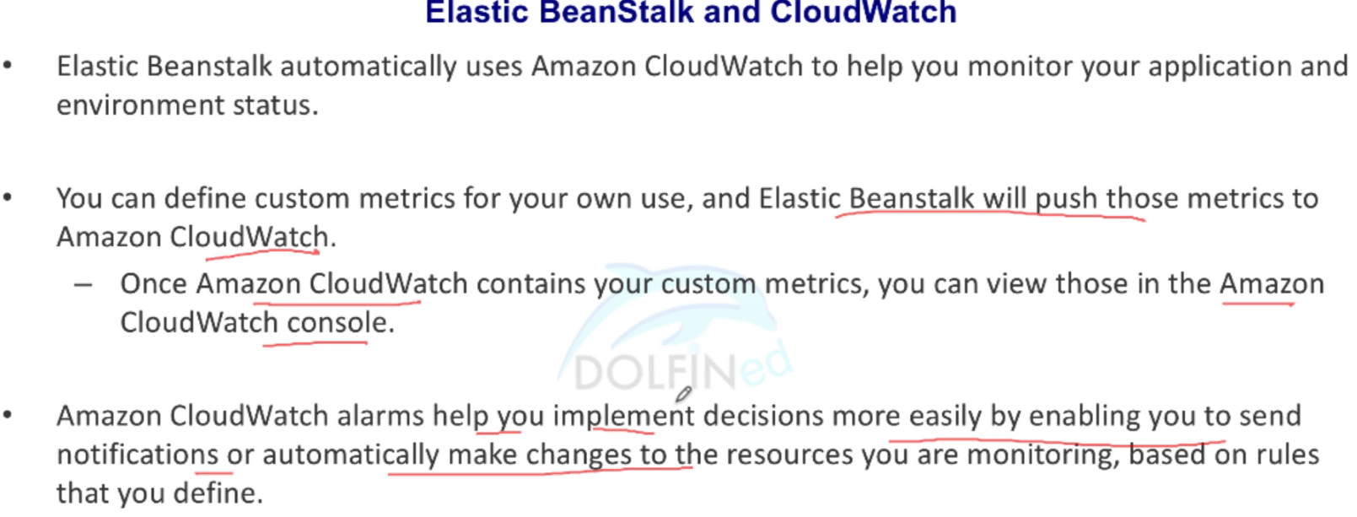
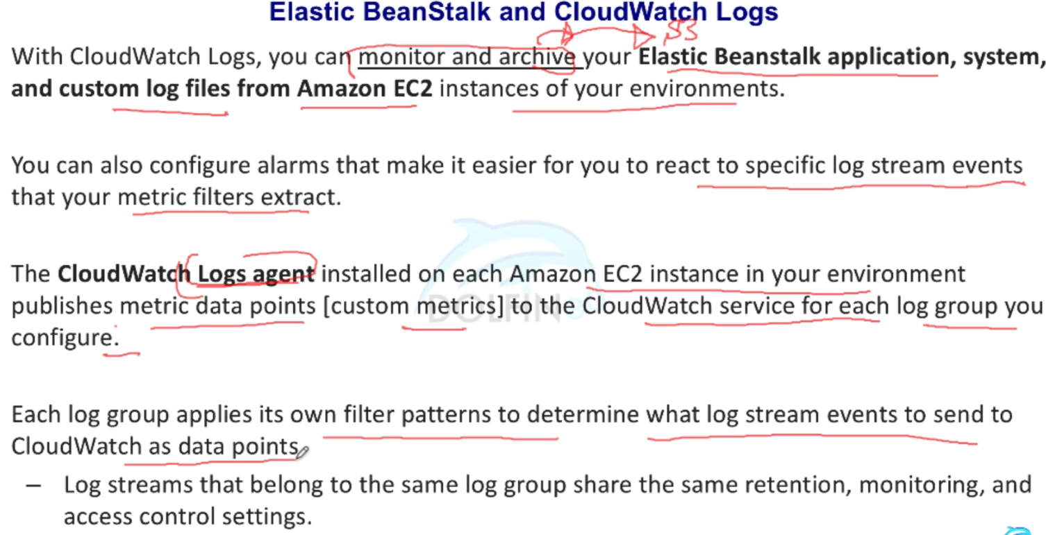
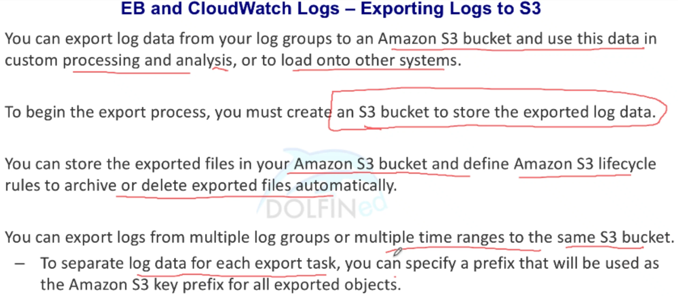
AWS Elastic Beanstalk - monitoring & logging

Slide 29
CloudTrail

Slide 30
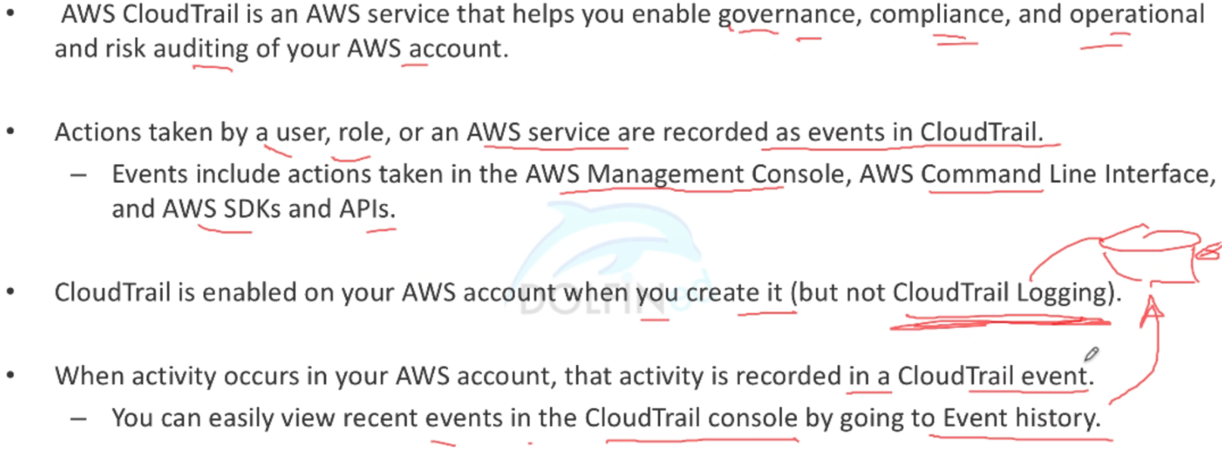
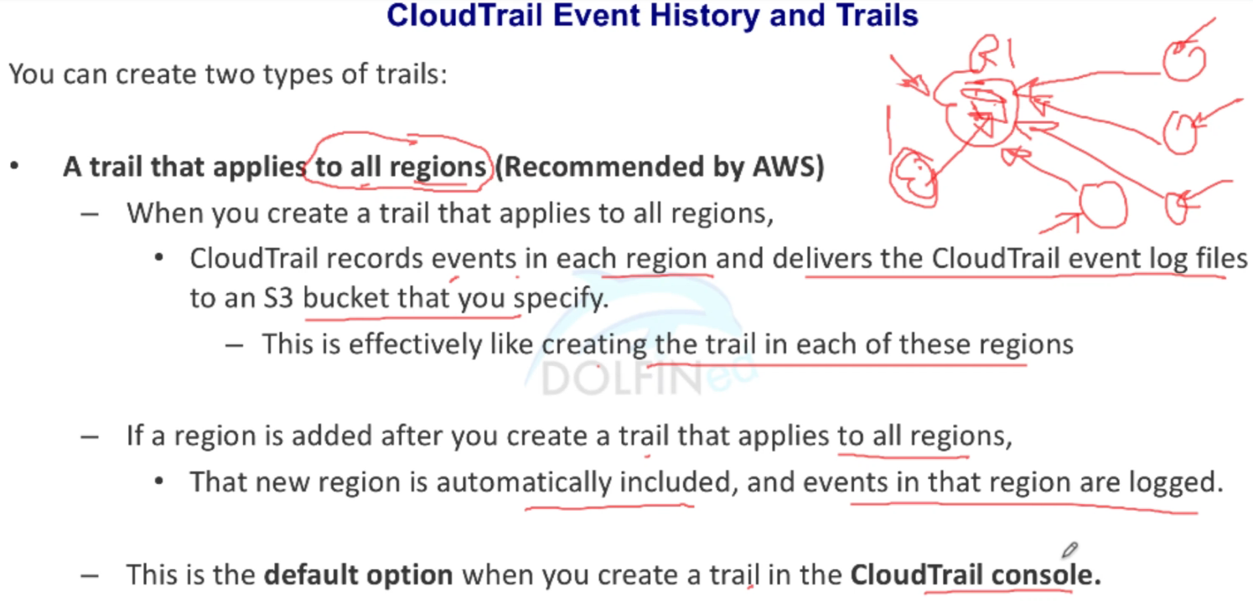
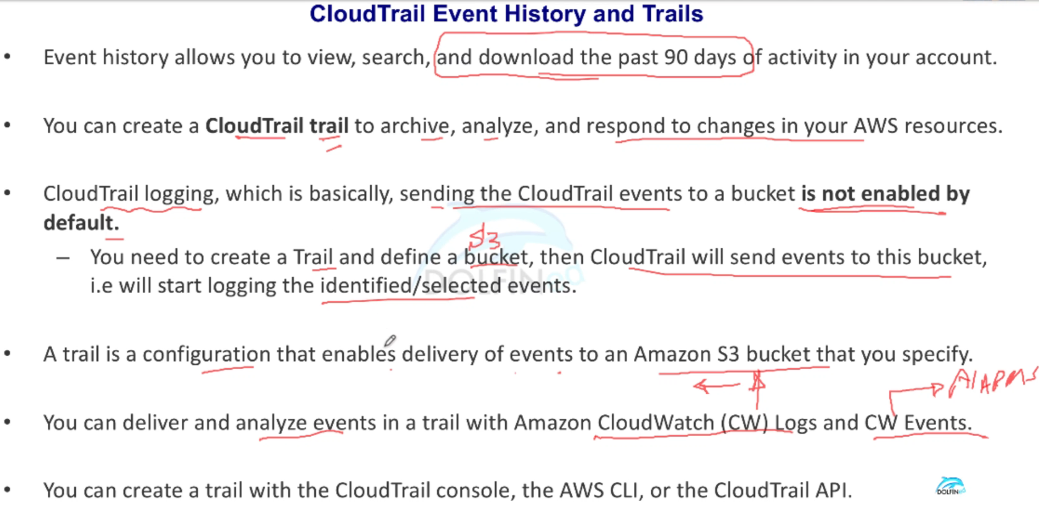
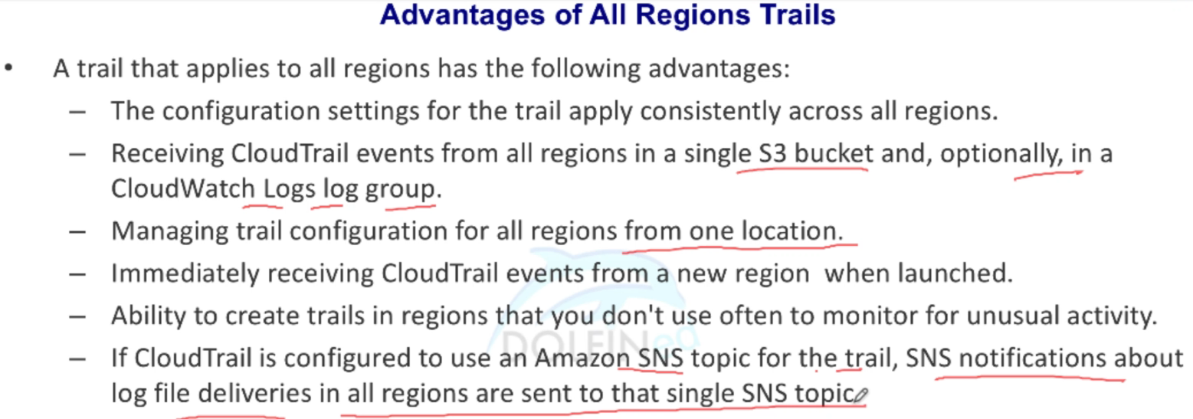
AWS CloudTrail - Intro

Slide 31
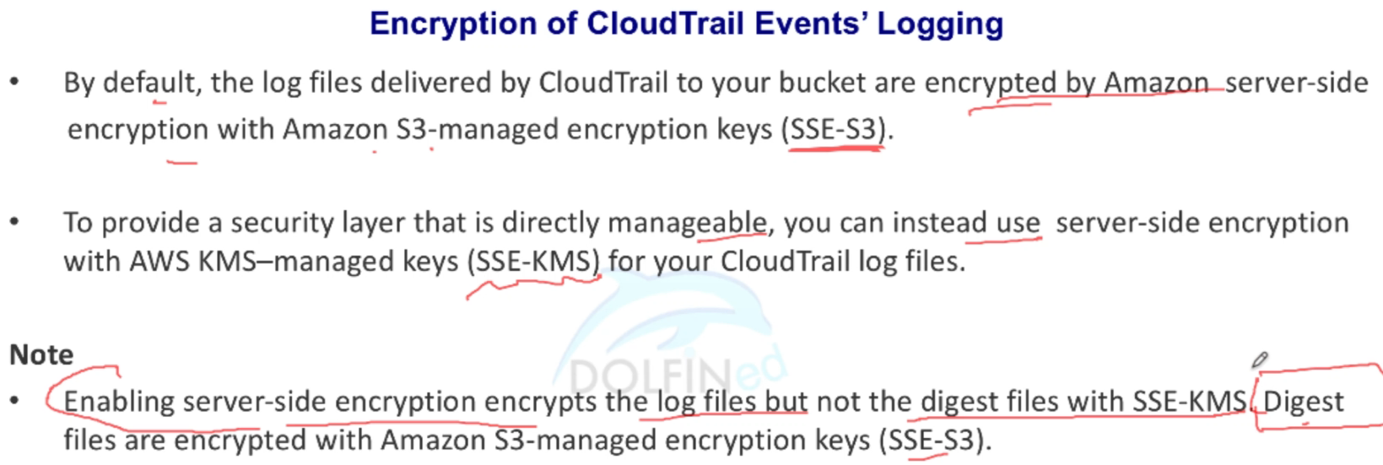
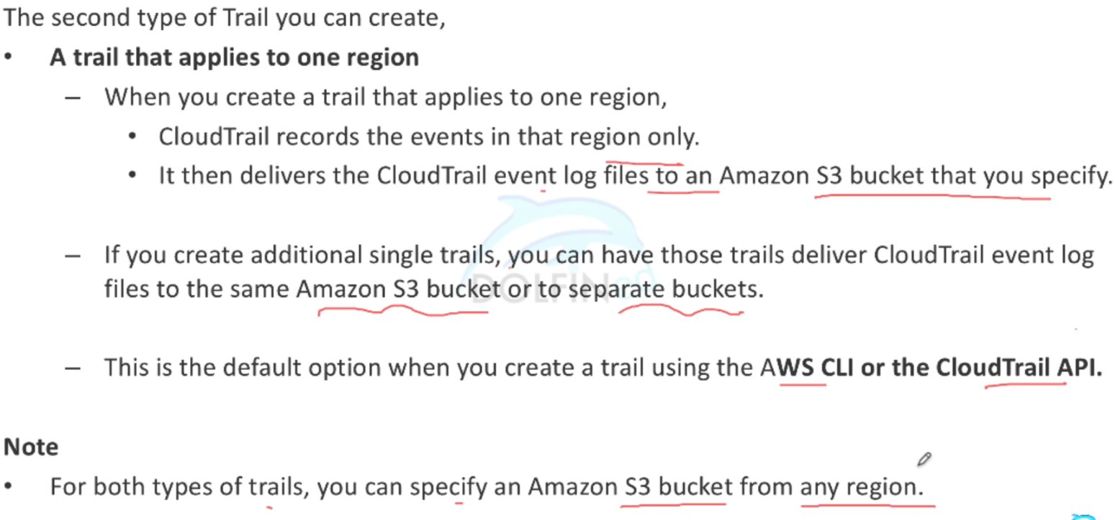
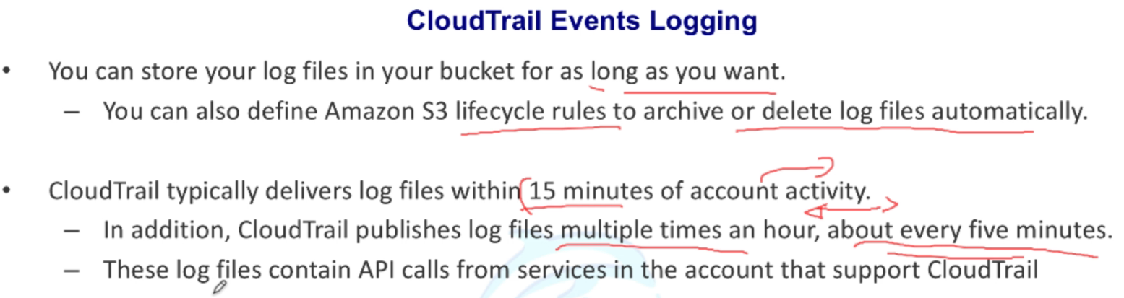
AWS CloudTrail - Intro

Slide 32
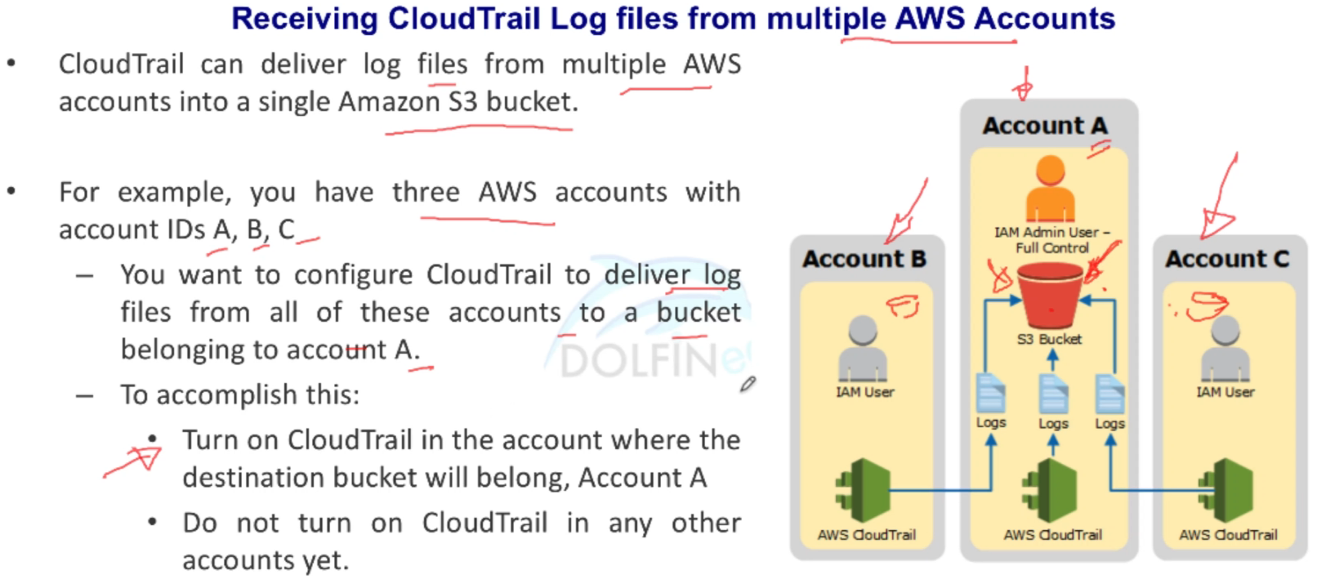
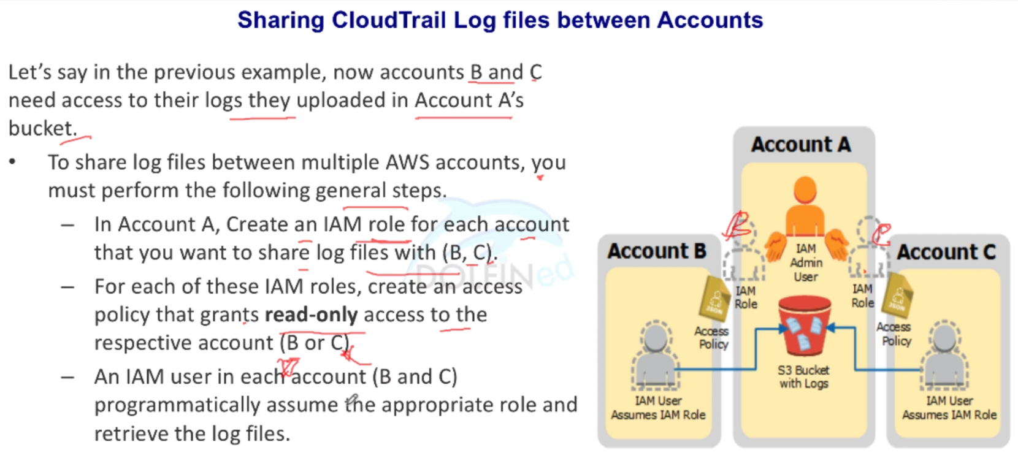
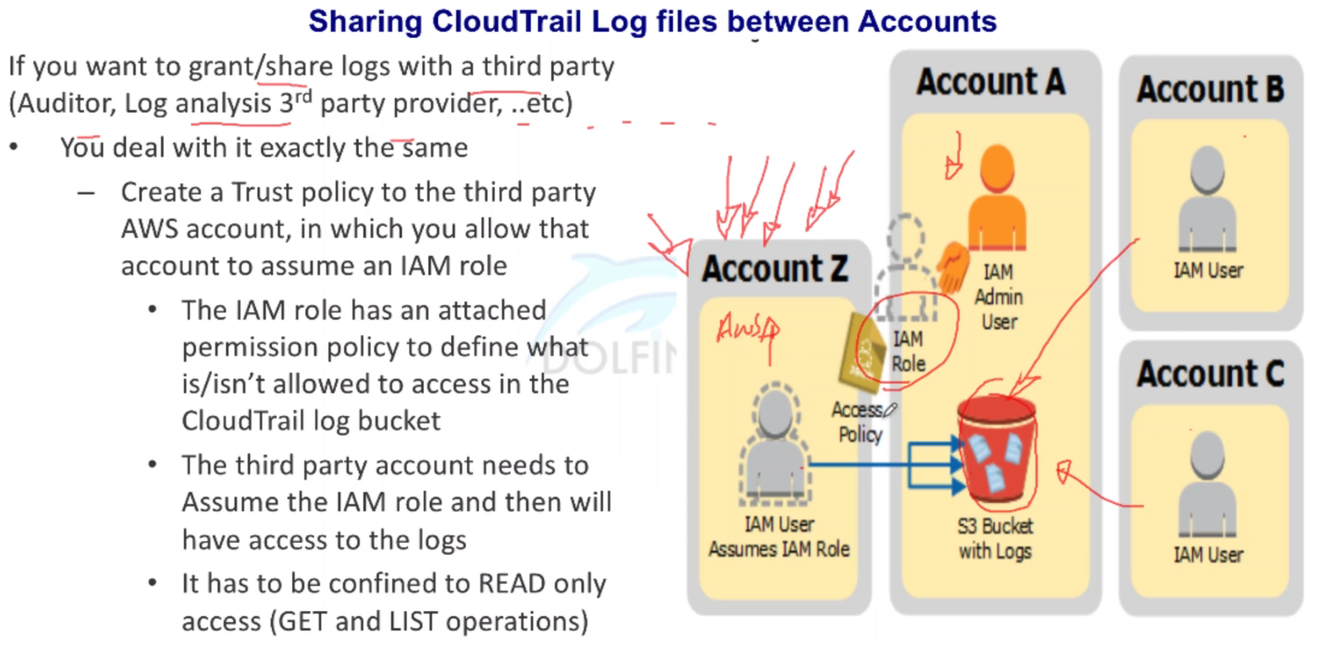
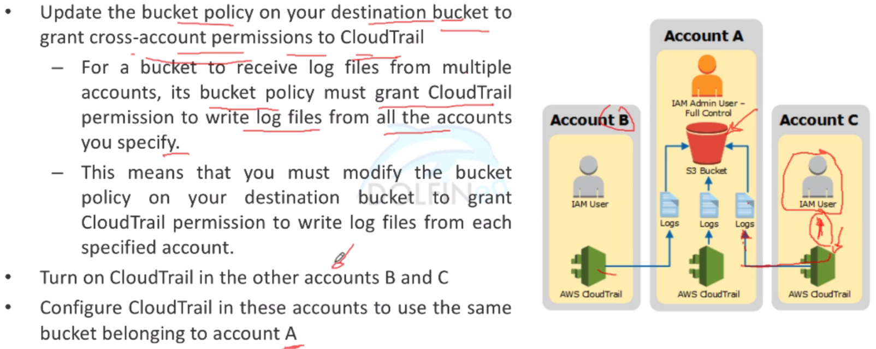
Cross-Account Scenarios

Slide 33
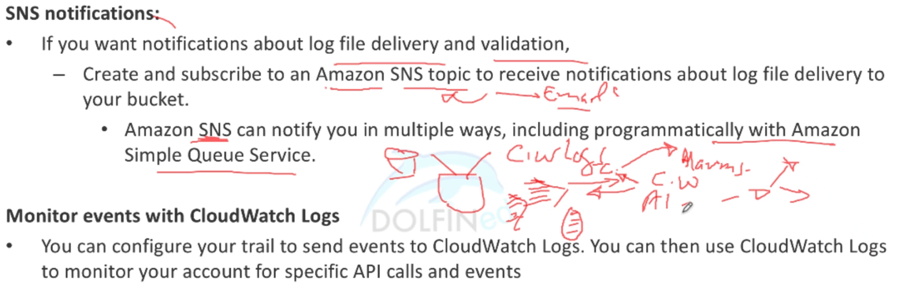
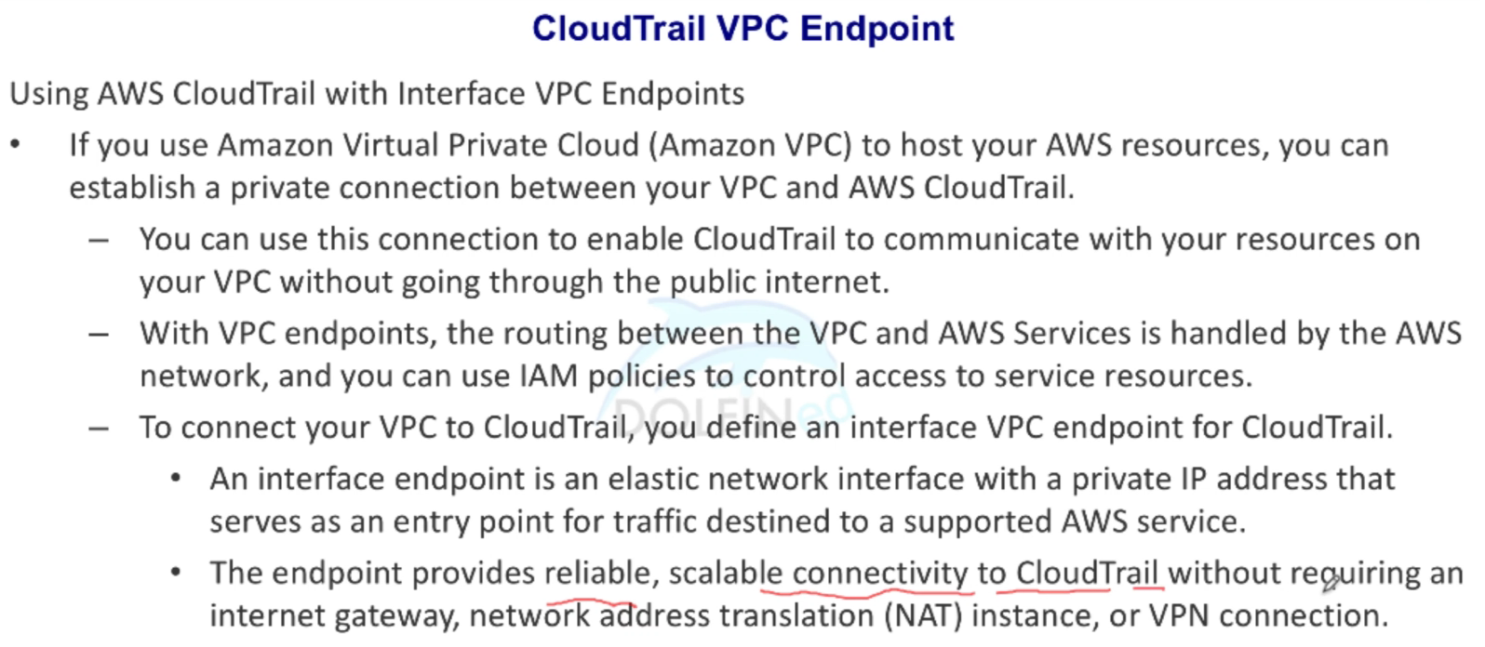
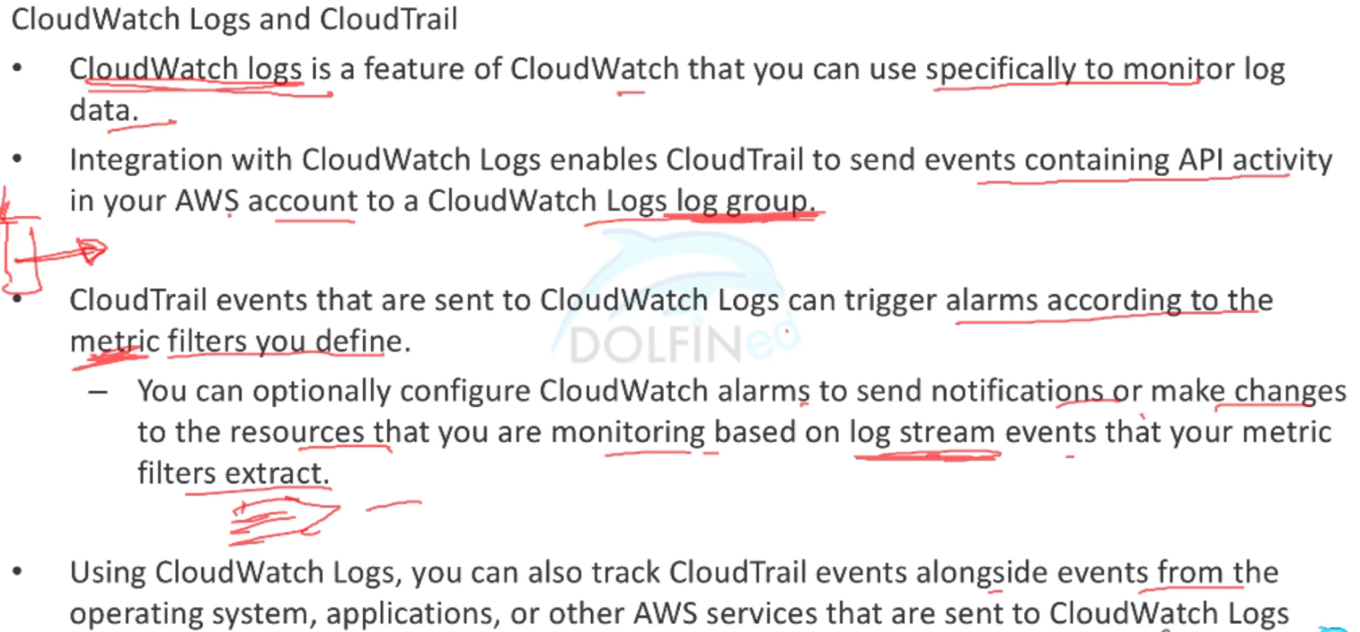
CloudTrail Monitoring

Slide 34
OpsWorks
elastic beanstalk is the high level offering. it is the simplest way to deploy an application on aws. if you're looking for a no-frills, automagic, as-fully-managed-as-you-can-get-in-aws experience, this is it.
opsworks is the middle tier. operating as a full featured orchestration tool (thus the tight relationship with chef), opsworks combines straightforward deployment, configuration and management with the flexibility to handle complex implementations.
cloudformation is the nuts and bolts, low level utility. when you want granular control over everything in your environment, cfn is the choice. cfn can handle pretty much anything - from tiny footprint, one instance web server deployments to netflix - with a templatized, code driven approach. if you're doing serious work with aws, you're probably using cloudformation.

Slide 35
AWS OpsWorks
AWS OpsWorks is a configuration management service that helps you configure and operate applications in a cloud enterprise by using Puppet or Chef.
AWS OpsWorks Stacks - the original service, provides a simple and flexible way to create and manage stacks and applications. AWS OpsWorks Stacks lets you deploy and monitor applications in your stacks. You can create stacks that help you manage cloud resources in specialized groups called layers. A layer represents a set of EC2 instances that serve a particular purpose, such as serving applications or hosting a database server. Layers depend on Chef recipes to handle tasks such as installing packages on instances, deploying apps, and running scripts.
AWS OpsWorks for Chef Automate - lets you use Chef cookbooks and solutions for configuration management. lets you create AWS-managed Chef servers that include Chef Automate premium features, and use the Chef DK and other Chef tooling to manage them. A Chef server manages nodes in your environment, stores information about those nodes, and serves as a central repository for your Chef cookbooks.
OpsWorks for Puppet Enterprise lets you configure a Puppet Enterprise master server in AWS.

Slide 36
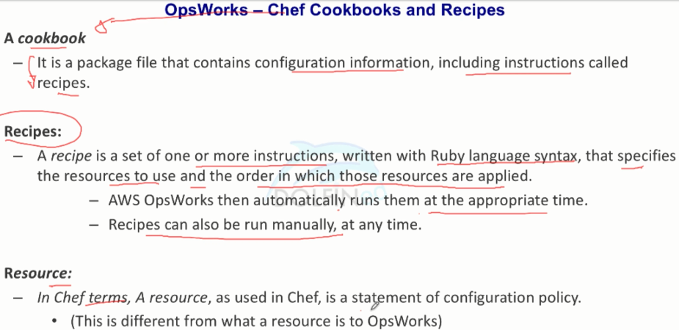
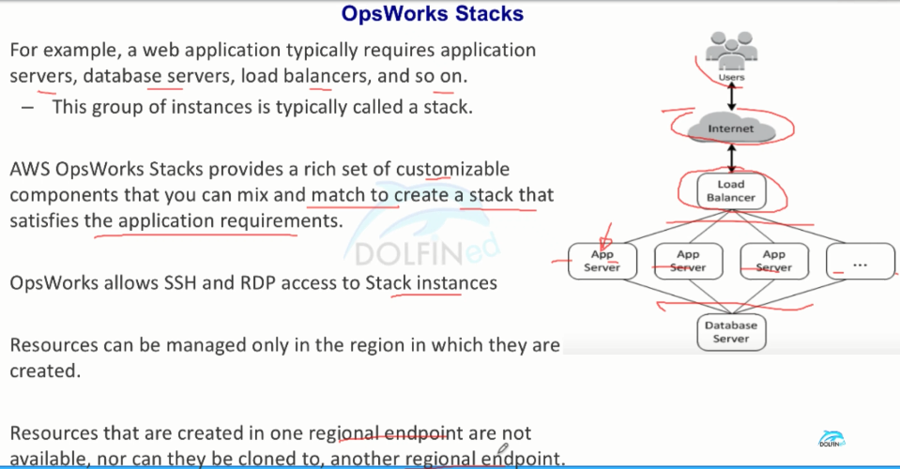
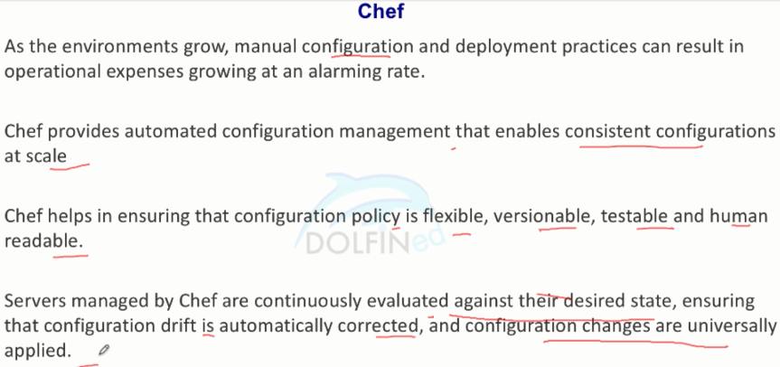
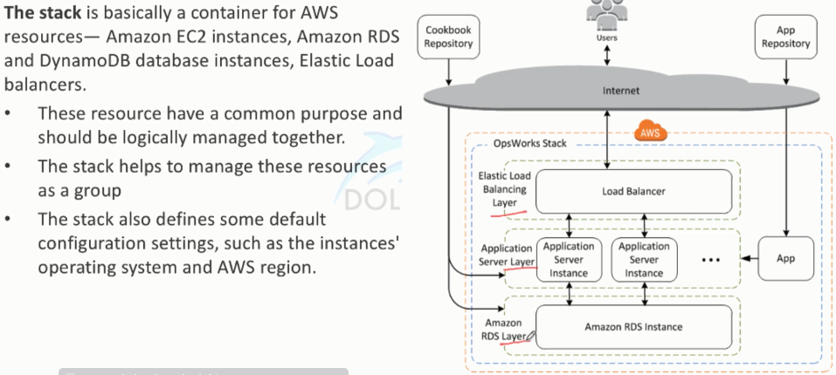
AWS OpsWorks

Slide 37





AWS OpsWorks

Slide 38




AWS OpsWorks

Slide 39



AWS OpsWorks
Stacks → Layers → Instances → Apps

Slide 40
AWS Config

Slide 41




AWS Config

Slide 42




AWS Config

Slide 43



AWS Config

Slide 44

How to Use AWS Config to Monitor for and Respond to Amazon S3 Buckets Allowing Public Access
https://aws.amazon.com/blogs/security/how-to-use-aws-config-to-monitor-for-and-respond-to-amazon-s3-buckets-allowing-public-access/
AWS Config enables continuous monitoring of your AWS resources, making it simple to assess, audit, and record resource configurations and changes. AWS Config does this through the use of rules that define the desired configuration state of your AWS resources. AWS Config provides a number of AWS managed rules that address a wide range of security concerns such as checking if you encrypted your EBS volumes, tagged your resources appropriately, and enabled MFA for root accounts. You can also create custom rules to codify your compliance requirements through the use of AWS Lambda functions.
Enable Config to monitor S3 bucket ACLs and policies for compliance violations.
Create an IAM Role and Policy that grants a Lambda function permissions to read S3 bucket policies and send alerts through SNS.
Create and configure a CloudWatch Events rule that triggers the Lambda function when AWS Config detects an S3 bucket ACL or policy violation.
Create a Lambda function that uses the IAM role to review S3 bucket ACLs and policies, correct the ACLs, and notify your team of out-of-compliance policies.
Verify the monitoring solution.

